Slide 1
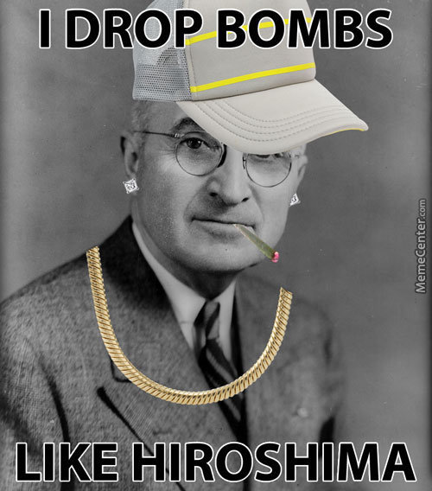
Tuesday, February 14th
Sporting News:
Girls/Boys Bball @ Friday
Senior Announcements:
Sign up on REMIND App
Class Announcements:
Turn in Contracts by MONDAY
1st Comp Check – Next Friday
Agenda:
Go over the Syllabus
Go over the contract & Procedures
Quick IceBreaker Game
Silent Debate

Slide 2
Pink Paper
Think of a person or event from 1st or 2nd trimester
Secretively write that down on your paper
Under that term, make a bulleted list of some characteristics or facts that you remember about that term

Slide 3
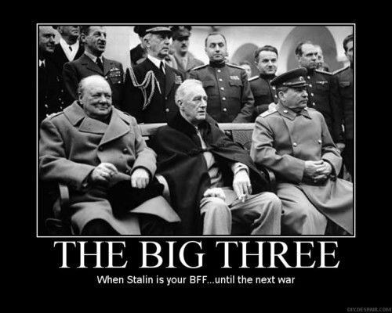
Friday, February 17th
Sporting News:
Girls/Boys Bball @ Tonight
Senior Announcements:
Sign up on REMIND App
House of Boom
Class Announcements:
Turn in Contracts by MONDAY
1st Comp Check – Next Friday
Agenda:
LT, Vocab & Journal
Yalta & Potsdam Assignment
Read Chp 18 TST & Answer ?s
PPT & Note-Taking Practice

Slide 4
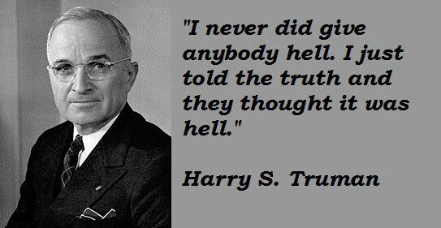
Monday, February 20th
Sporting News:
Girls/Boys Districts
Senior Announcements:
House of Boom
Class Announcements:
Turn in Contracts by TODAY
1st Comp Check – Friday
Agenda:
LT, Vocab & Journal
Quick Lecture & Notes (9 mins)
Mapping Activity

Slide 5
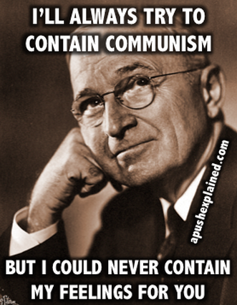
Tuesday, February 21st
Sporting News:
Girls/Boys Districts
Senior Announcements:
House of Boom
Class Announcements:
Turn in Contracts by TODAY
1st Comp Check – Friday
Bring Headphones tomorrow
Agenda:
LT, Vocab & Journal
Quick Lecture & Notes (12 mins)
Berlin Airlift Activity

Slide 6
Wednesday, February 22nd
Sporting News:
Congrats Girls Bball on Season!!!
Boys Districts – Tonight 7:30
Senior Announcements:
House of Boom
Class Announcements:
Turn in Contracts by TODAY
1st Comp Check – Friday
Agenda:
LT, Vocab & Journal
BlendSpace Activity (w/a partna)

Slide 7
Visit www.ferncreekushistory.weebly.com
Unit Topics
Cold War Beginnings
Scroll down to the “BLENDSPACE” Activity
Complete the activity in your packets

Slide 8
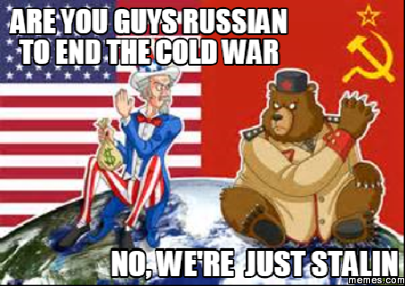
Thursday, February 23rd
Sporting News:
Congrats Girls Bball on Season!!!
Boys Districts – Friday 7:00
Senior Announcements:
House of Boom
Class Announcements:
Turn in Contracts by TODAY
1st Comp Check – Tomorrow!!!
Agenda:
NO New LT, Vocab or Journal
Finish BlendSpace Activity (20-25 mins)
Read Korean War Summary
PPT, Lecture & Notes – Korean War

Slide 9
Friday, February 24th
Sporting News:
Congrats Girls Bball on Season!!!
Boys Districts – Tonight 7:00
Senior Announcements:
March 3rd – Sr Trip Pay
Class Announcements:
Turn in Contracts by TODAY
1st Comp Check – Today!!!
Agenda:
NO New LT, Vocab or Journal
Finish Korean War Summary
Korean War Debate
Take Competency Check

Slide 10
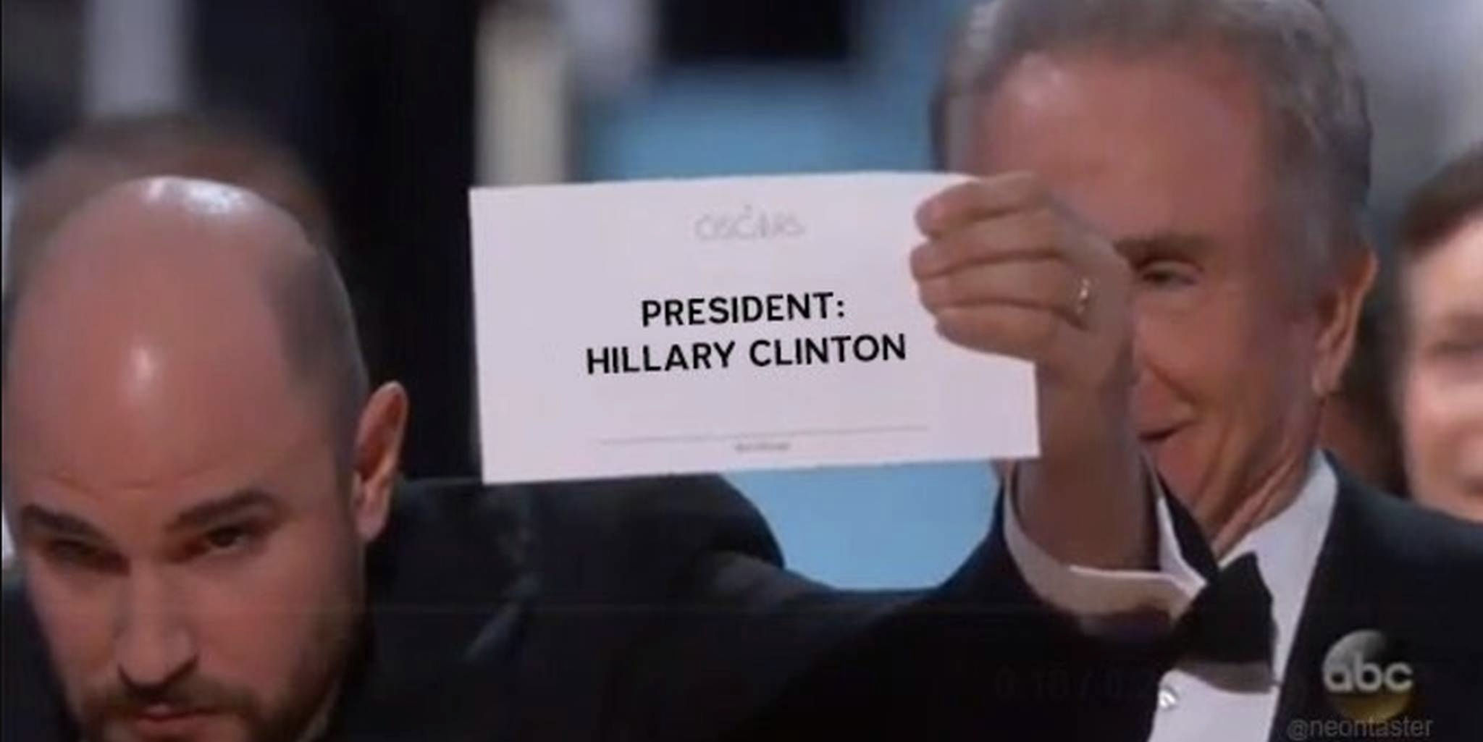
Tuesday, February 28th
Sporting News:
Boys Regional Bball VS. Desales 7:00
Senior Announcements:
March 3rd – Sr Trip Pay
Class Announcements:
Enrichment / Redemption Today
Agenda:
Enrichment / Redemption
Be sure to take retest before class ends
Be sure to turn in something today

Slide 11
Wednesday, March 1st
Sporting News:
Boys Regional BBall
Senior Announcements:
March 3rd – Sr Trip Pay Due
Class Announcements:
Next Comp Check – next Thursday
First Proficiency Exam – Fri 3/17
Agenda:
New LT, Vocab & Warm-Up
Discuss Baby Boom, GI Bill
PPT & Cornell – 1950s Domestic Issues
Begin IKE presidency assignment

Slide 12
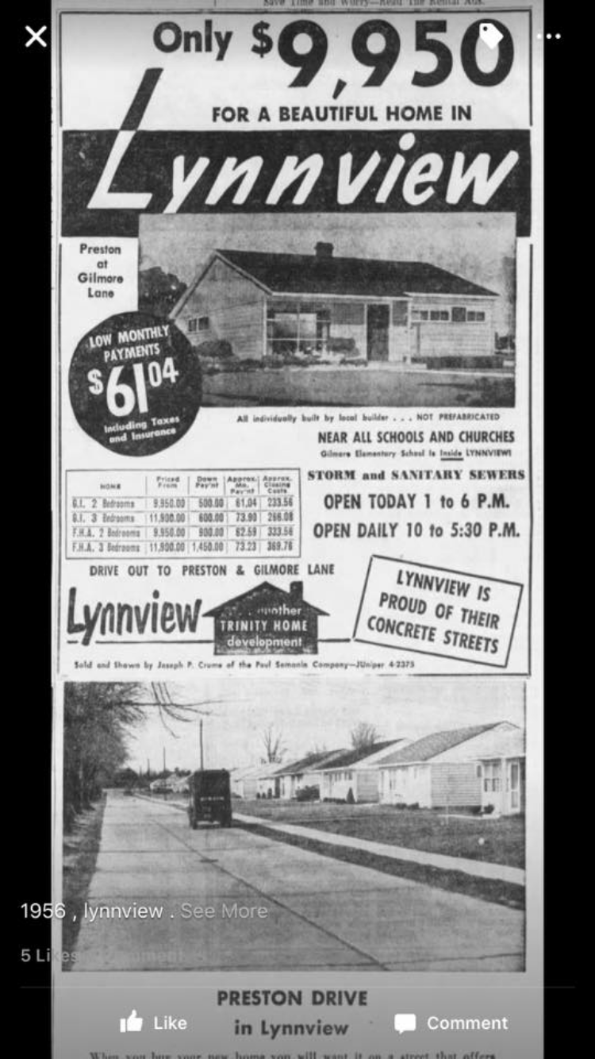
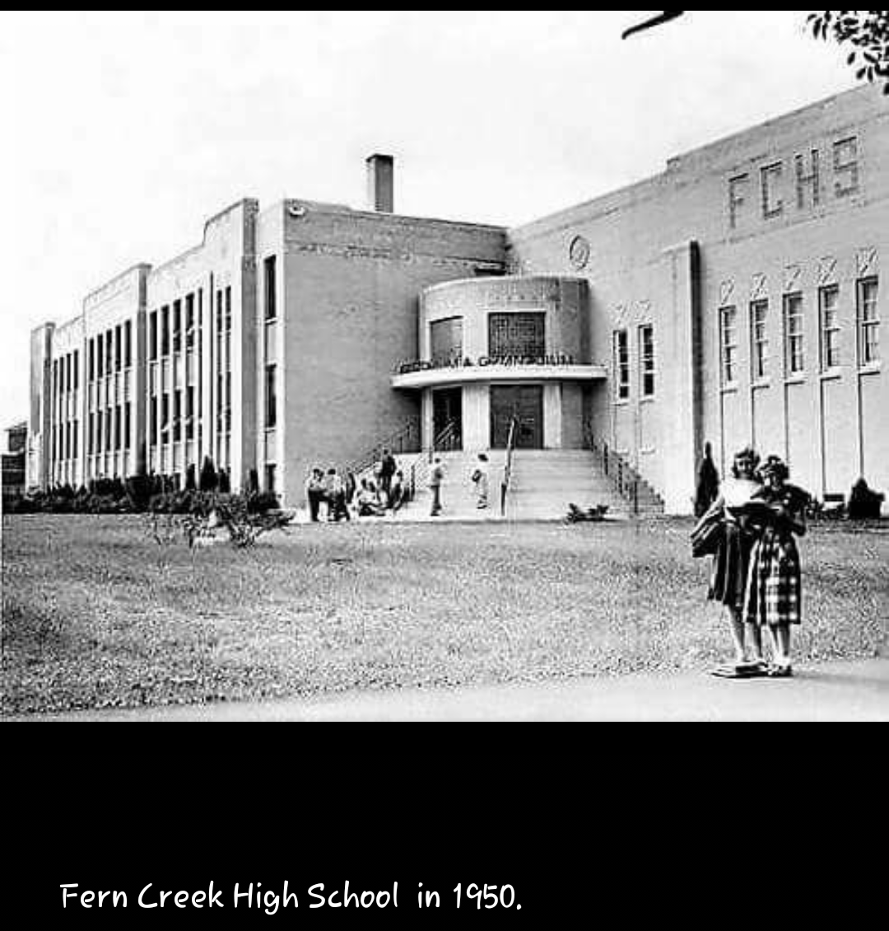

Slide 13
Review
What is the main purpose of the Truman Doctrine?
How did the Marshall Plan work?
What is one way America used the Marshall Plan?
What is NATO and what is it a response to?
What two events happened in 1949 that freaked out Americans?
Why did Ike say we were fighting the Korean War?
What changed at the end of the Korean War?
Name the government agency used the most to try to find communists living in America.

Slide 14
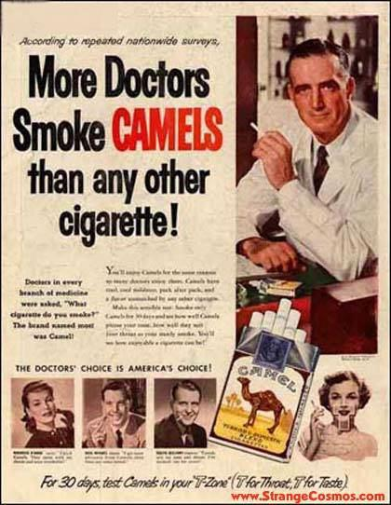
Thursday, March 2nd
Sporting News:
Boys Regional BBall
Senior Announcements:
March 3rd – Sr Trip Pay Due
Class Announcements:
Next Comp Check – next Thursday
First Proficiency Exam – Fri 3/17
Agenda:
New LT, Vocab & Warm-Up
Cause-and-effect Chart
Finish IKE presidency assignment
Finish PPT & Cornell Notes – 50s Domestic

Slide 15
Friday, March 3rd
Sporting News:
Boys Regional BBall
Senior Announcements:
March 3rd – Sr Trip Pay Due
Class Announcements:
Next Comp Check – Thursday
First Proficiency Exam – Fri 3/17
Bring headphones Monday
Agenda:
New LT, Vocab & Warm-Up
Finish PPT & Cornell Notes
Chp 19 Reading
Begin 50s Teenager Project

Slide 16
Review
What is the main purpose of the Truman Doctrine?
How did the Marshall Plan work?
What is one way America used the Marshall Plan?
What is NATO and what is it a response to?
What two events happened in 1949 that freaked out Americans?
Why did Ike say we were fighting the Korean War?
What changed at the end of the Korean War?
Name the government agency used the most to try to find communists living in America.
What is mccarthyism?
Describe the interstate highway act
What is the name of the vaccine developed for polio in the 50s?
What was the biggest industry of the decade?

Slide 17
Monday, March 6th
Sporting News:
Boys Regional Final!
Senior Announcements:
Senior Meeting Today!!!
Class Announcements:
Next Comp Check – Thursday
First Proficiency Exam – Fri 3/17
Agenda:
New LT, Vocab & Warm-Up
PPT & Cornell Notes – JFK Presidency
Begin JFK Blendspace Activity!!!

Slide 18
Review
What is the main purpose of the Truman Doctrine?
What is a Levittown?
What is mccarthyism?
What was the HUAAC?
What is one way America used the Marshall Plan?
What is NATO and what is it a response to?
What two events happened in 1949 that freaked out Americans?
Describe the interstate highway act.
Why did Ike say we were fighting the Korean War?
What changed at the end of the Korean War?
How did the Marshall Plan work?
What is the name of the vaccine developed for polio in the 50s?
What was the biggest industry of the decade?
Name the government agency used the most to try to find communists living in America.
Name one of the two incidents where spies were discovered in America.

Slide 19
Tuesday, March 7th
Sporting News:
Regional Bball!!!
Senior Announcements:
Money, Money, Money
Class Announcements:
Next Comp Check – Friday
First Proficiency Exam – Fri 3/17
Agenda:
New LT, Vocab & Warm-Up
Finish JFK Blendspace Activity!!!
Start PLEASANTVILLE

Slide 20
Review
What is the main purpose of the Truman Doctrine?
What is a Levittown?
What is mccarthyism?
What was the HUAAC?
Explain the Cuban Missile Crisis
What two events happened in 1949 that freaked out Americans?
Describe the interstate highway act.
In what areas did the “New Frontier” focus?
What changed at the end of the Korean War?
What is the name of the vaccine developed for polio in the 50s?
What was the biggest industry of the decade?
What is White Flight???
Name the government agency used the most to try to find communists living in America.
Name one of the two incidents where spies were discovered in America.
What happened at the Bay of Pigs?

Slide 21
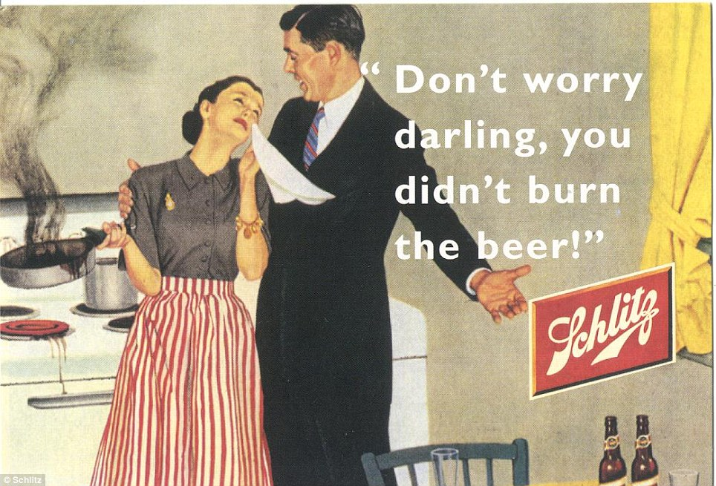
Wednesday, March 8th
Sporting News:
Boys Sweet 16!!!
Senior Announcements:
Next Senior Event
3/27 Kart Kountry
Class Announcements:
Next Comp Check – Friday!
First Proficiency Exam – Fri 3/17
Agenda:
New LT, Vocab & Warm-Up
Begin PLEASANTVILLE

Slide 22
Review
What is the main purpose of the Truman Doctrine?
What is a Levittown?
What is mccarthyism?
What was the HUAAC?
Explain the Cuban Missile Crisis
What two events happened in 1949 that freaked out Americans?
Describe the interstate highway act.
In what areas did the “New Frontier” focus?
What changed at the end of the Korean War?
What is the name of the vaccine developed for polio in the 50s?
What was the biggest industry of the decade?
What is White Flight???
Name the government agency used the most to try to find communists living in America.
Name one of the two incidents where spies were discovered in America.
What happened at the Bay of Pigs?

Slide 23
Thursday, March 9th
Sporting News:
Boys Sweet 16!!!
Senior Announcements:
3/27 Kart Kountry
Class Announcements:
Next Comp Check – Friday!
First Proficiency Exam – Fri 3/17
Agenda:
Quick Review and Recap
Answer the Big Question in your packets
Finish PLEASANTVILLE

Slide 24
Review
Bombs on Japan
Truman Doctrine
Berlin Airlift
Marshall Plan
Korean War
38th Parallel
China falls to Communism
Russia tests bomb
Brinkmanship
NATO / Warsaw Pact
Russian launch Sputnik
U-2 Incident
Bay of Pigs
Cuban Missile Crisis
GI Bill
Levittowns
JFK / Nixon Debates
Interstate Highway Act
Polio Vaccine
Space Race
New Frontier
Moon Landing
Alger Hiss
The Rosenbergs

Slide 25
Review
What is the main purpose of the Truman Doctrine?
What is a Levittown?
What is mccarthyism?
What was the HUAAC?
Explain the Cuban Missile Crisis
What two events happened in 1949 that freaked out Americans?
Describe the interstate highway act.
In what areas did the “New Frontier” focus?
What changed at the end of the Korean War?
What is the name of the vaccine developed for polio in the 50s?
What was the biggest industry of the decade?
What is White Flight???
Name the government agency used the most to try to find communists living in America.
Name one of the two incidents where spies were discovered in America.
What happened at the Bay of Pigs?

Slide 26
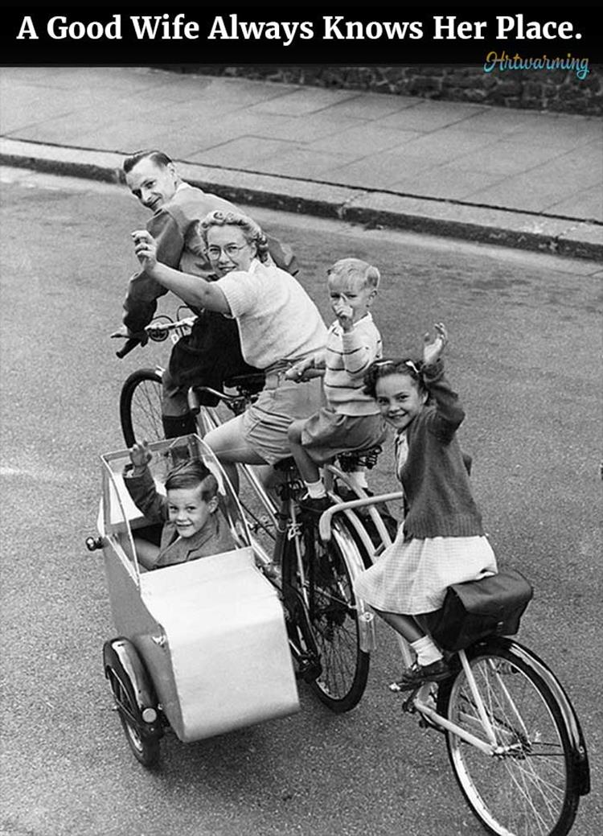
Friday, March 10th
Sporting News:
Boys Sweet 16!!!
Senior Announcements:
3/27 Kart Kountry
Class Announcements:
Comp Check Today
Begin Enrichment / Redemption Today Also
First Proficiency Exam – Fri 3/17
Agenda:
Take Comp Check
Finish Pleasantville
Begin Enrichment / Redemption

Slide 27
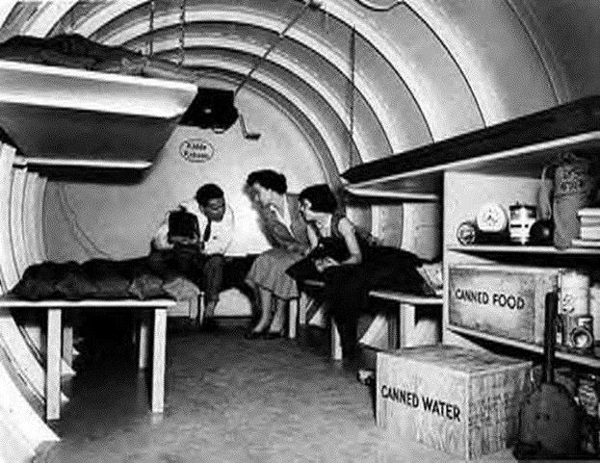

Slide 28
Review
What is the main purpose of the Truman Doctrine?
What is a Levittown?
What is mccarthyism?
What was the HUAAC?
Explain the Cuban Missile Crisis
What two events happened in 1949 that freaked out Americans?
Describe the interstate highway act.
In what areas did the “New Frontier” focus?
What changed at the end of the Korean War?
What is the name of the vaccine developed for polio in the 50s?
What was the biggest industry of the decade?
What is White Flight???
Name the government agency used the most to try to find communists living in America.
Name one of the two incidents where spies were discovered in America.
What happened at the Bay of Pigs?

Slide 29
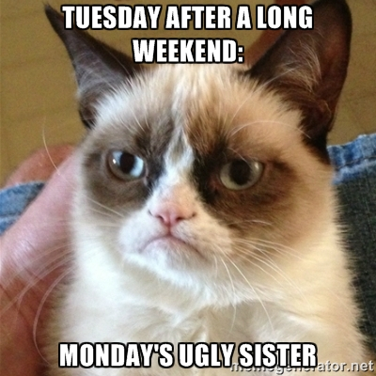
Tuesday, March 14th
Sporting News:
Boys Sweet 16 - Thursday
Senior Announcements:
3/27 Kart Kountry – more info coming
Class Announcements:
Begin Enrichment / Redemption Today Also
First Proficiency Exam – Fri 3/17
Agenda:
Begin Enrichment - choose different from first time
Begin Redemption
Reading packet
Retake

Slide 30
Conspiracy Theory Assignment
For your assignment, you will research a well-known conspiracy theory and decide what you believe. This will be a position paper, trying to convince the reader (me) of your idea. Your paper will require research into both sides of the argument, which must be cited at the end of the assignment. To write a position paper, you must not only convince the reader why you are right, but also say why the other side is wrong. Don't forget to refute the argument from the other side. Conspiracies to choose from:
The JFK assassination
The Moon landing
Sinking of the USS Maine

Slide 31
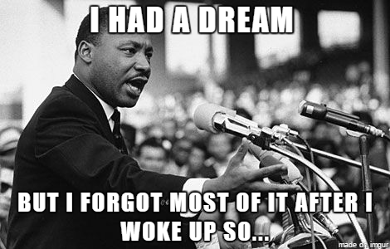
Wednesday, March 15th
Sporting News:
Boys Sweet 16 – Tomorrow!!!
Senior Announcements:
3/27 Kart Kountry – more info coming
Class Announcements:
First Proficiency Exam – Tues 3/21
Agenda:
Finish Enrichment / Redemption and turn in!!!!!
Civil Rights Movement Introduction
Civil Rights Projects Begin

Slide 32
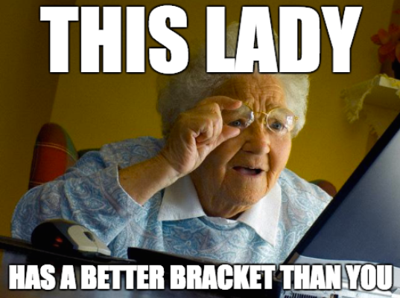
Friday, March 17th
Sporting News:
Boys Sweet 16 – Tonight
Bus $10
Senior Announcements:
3/27 Kart Kountry – more info coming
Class Announcements:
First Proficiency Exam – Tues 3/21
Agenda:
Civil Rights Projects Begin
Stay on Task!!!
I want to see a work product by the end of the period

Slide 33
Monday, March 20th
Sporting News:
Baseball / Softball
Senior Announcements:
3/27 Kart Kountry – more info coming
Class Announcements:
First Proficiency Exam – Thurs 3/23
Agenda:
Civil Rights Projects Continue
Stay on Task!!!
You should be working on both the presentation and the demonstration today

Slide 34
Tuesday, March 21st
Sporting News:
Baseball / Softball this week
Senior Announcements:
3/27 Kart Kountry – more info coming
Class Announcements:
First Proficiency Exam – Fri 3/24
Study Guide Due Friday
Agenda:
Civil Rights Projects Continue
Stay on Task!!!
You should be working on both the presentation and the demonstration today

Slide 35
Your Presentation
Is it mainly visuals and titles only?
Does it cover all the main points on your handouts?
Does everyone have a part? Is everyone holding up to their part?
What about STEP 2? What do you need from Coach Abell?

