Slide 1
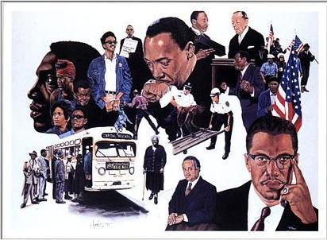
Civil Rights Movement

Slide 2
The Civil Rights Movement prior to 1954
Pre-1900
Slavery in colonial days gradually reduced to South
Abolition movement and Civil War
Reconstruction and Amendments
1896 Plessy v. Ferguson allowed the segregation of African Americans and whites.
To 1930
Marcus Garvey, Booker T. Washington, and W.E.B. Du Bois
Founding of the NAACP in 1909
Great Migration and Harlem Renaissance
Roosevelt unwilling to push too hard for greater African American rights.
To 1940
A. Philip Randolph forced a federal ban against discrimination in defense work.
1940s founding of CORE
President Truman desegregated the armed forces.
Brooklyn Dodgers put an African American—Jackie Robinson—on its roster.

Slide 3
Didn’t the Civil War Solve Everything?
At the end of the Civil War the Constitution was amended to give Blacks more rights:
13th Amendment: Abolished Slavery
14th Amendment: Gave Citizenship and Equal Protection of the Constitution
15th Amendment: Right to Vote

Slide 4
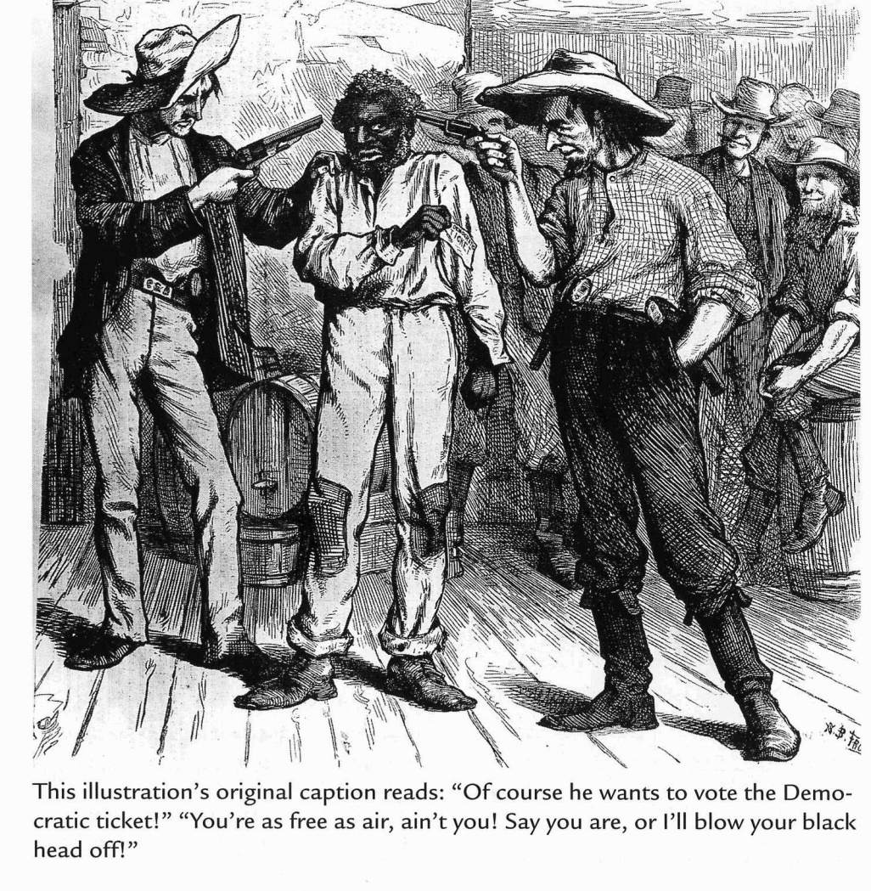
Reconstruction
Southern states rewrite constitutions
Blacks lose rights previously won
KKK emerges to harass Blacks
Federal and state gov’t. ignored duties
14th and 15th Amendments not enforced

Slide 5
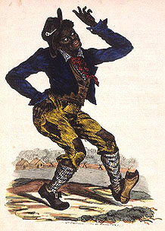
Plessy v. Ferguson (1896)
Court ruled 7-1 that Louisiana law segregating black from white train passengers was okay.
Doctrine of “Separate, But Equal” established legal segregation
“Jim Crow” laws spread to other facilities and states
Also called dejure segregation
Made Blacks second class citizens in the South
“Jim Crow” stage name in a minstrel show

Slide 6
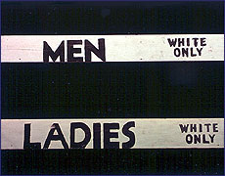
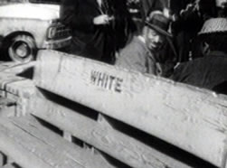
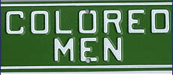
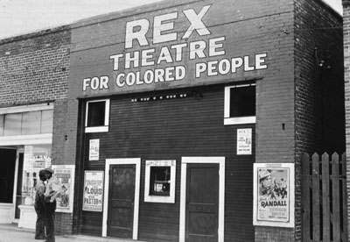
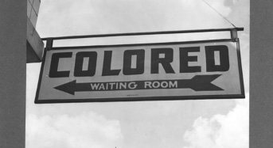
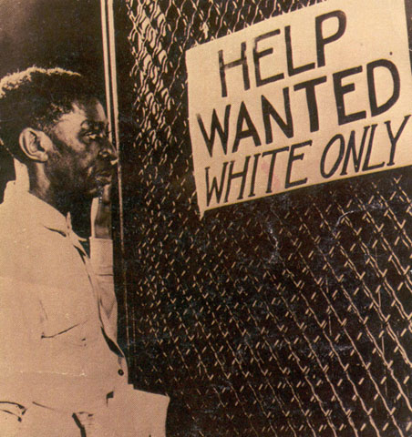
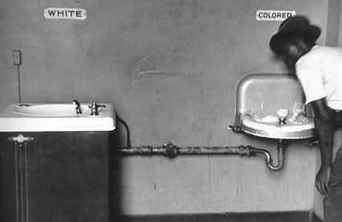
The South

Slide 7
Washington vs. DuBois
Washington has been a very controversial figure. Some historians say that he was a sell-out who kissed up to white people; others say he was realistic about the situation in the South, and tied to avoid inciting white hostility. What do you think?
What was DuBois’s critique of Washington? Do you think he makes a good point? Why or why not?
Why might some of Washington’s supporters say that DuBois didn’t understand what life was like in the South? Based on what he wrote, do you think DuBois was clueless about what was happening in the South?
Based on these documents, who do you think was a stronger advocate for the rights of African-Americans: Booker T. Washington or W.E.B. Dubois?

Slide 8
Seeking Change through the Courts
The NAACP attacked racism through the courts.
In the 1930s Charles Hamilton Houston and Thurgood Marshall began a campaign to attack the concept of “separate but equal.”
The NAACP began to chip away at the 1896 Supreme Court ruling in Plessy v. Ferguson—the legal basis for segregation.
Examples:
1938 – Missouri ex rel. Gaines v. Canada, Registrar of the University of Missouri
Court Rules: States must provide law schools for all qualified citizens; previously there was no law school in the state for Blacks…must either create one or integrate-Missouri creates new one
1950 – Sweatt v. Painter
Court Rules: A separate law school for Blacks, even with same teachers was not equal to that for Whites (need access to discussions and debates; University of Texas had to integrate their fine law school…all other states must integrate too

Slide 9
Brown v. Board of Education (1954)
NAACP and Thurgood Marshall began to focus on desegregating the nation’s elementary and high schools in the 1950s.
He found a case in Linda Brown of Topeka, Kansas.
Similar cases working their way in other states
The Supreme Court combined several school segregation cases from around the country into a single case: Brown v. Board of Education of Topeka, Kansas.
The Supreme Court was aware of this case’s great significance.

Slide 10
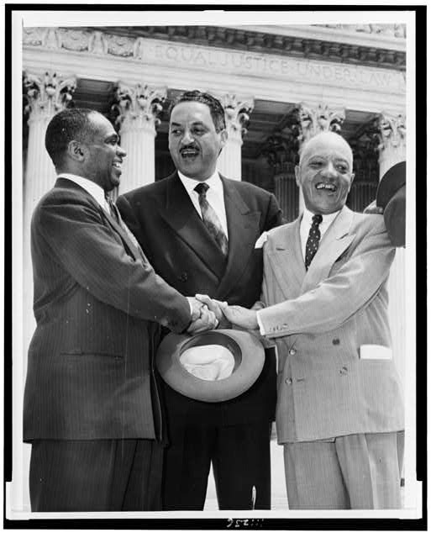
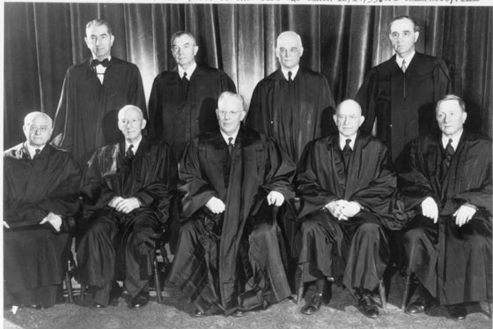
Brown v. Board of Education (1954)
The Supreme Court heard arguments over a two-year period.
The Court also considered research about segregation’s effects on African American children.
In 1954 Chief Justice Earl Warren issued the Supreme Court’s decision.
Unanimous verdict
Plessy v. Ferguson was overturned
“Warren Court” ordered integration with “all deliberate speed.”
What does this mean?
As soon as possible schools should be integrated
Earl Warren

Slide 11
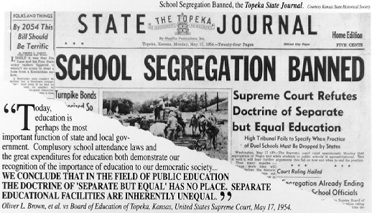

Slide 12
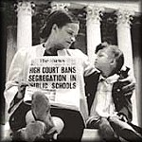
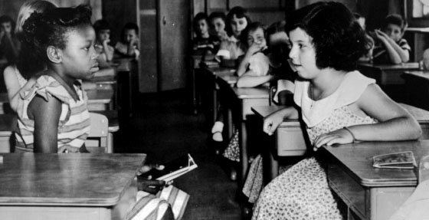
Results of Brown v. Board of Education (1954)
Most of the South did not voluntarily desegregate even after the Brown decision
Some governors stalled for a decade
President will have to risk political support and enforce Court’s ruling

Slide 13
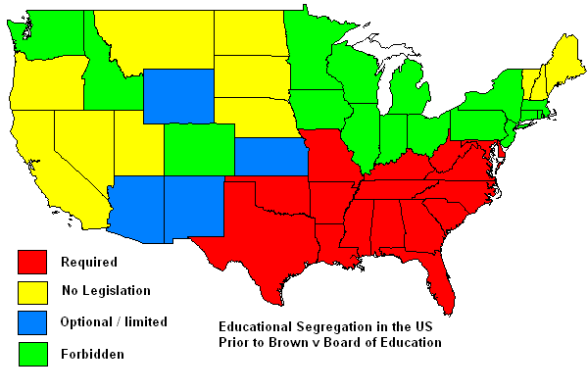
States Impacted By Ruling

Slide 14
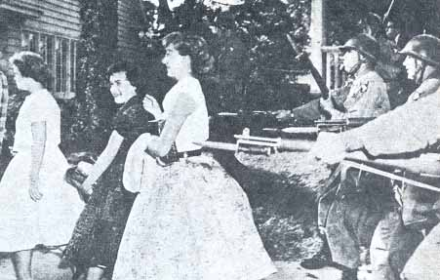
The Little Rock Crisis
Integration
The Supreme Court’s ruling did not offer guidance about how or when desegregation should occur.
Some states integrated quickly. Other states faced strong opposition.
Virginia passed laws that closed schools who planned to integrate.
In Little Rock, Arkansas, Governor Orval Faubus violated a federal court order to integrate Little Rock’s Central High School.
The Little Rock Nine
On September 4, 1957, angry whites harassed nine black students as they arrived at Little Rock’s Central High School.
The Arkansas National Guard turned the Little Rock Nine away and prevented them from entering the school for three weeks.
Finally, President Eisenhower sent 101st Airborne to escort the Little Rock Nine into the school.
The events in Little Rock revealed how strong racism was in some parts of the country.

Slide 15
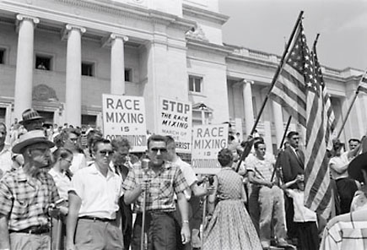
Primary Sources-Photographs

Slide 16
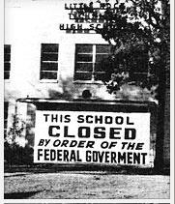
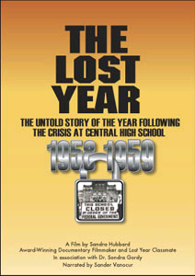
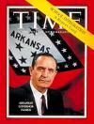
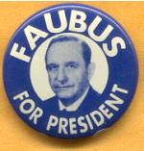
Little Rock, Arkansas Central High School (1957)
Ernest Green: 1st black student to graduate from Central High School.
In response, next year Governor Faubus closed the Little Rock schools in 1958-1959 so that integration couldn’t take place.
Favors Whites:
Greater ability to afford private schools and tutors
Parents more educated and able to home school
Control more jobs and can train who they want

Slide 17
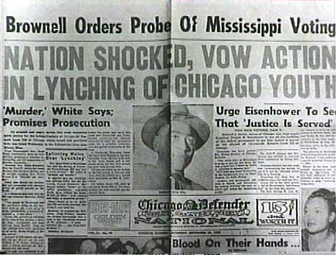
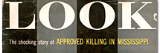
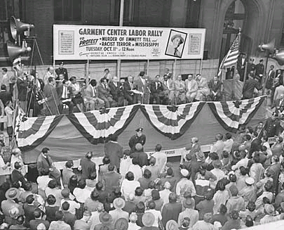
Emmett Till (1955)
Emmett Till, 14 yrs. old from Chicago
Went down to the Mississippi Delta for the first time to visit relatives.
Lynched for “inappropriate” conduct towards white female
Roy Bryant and J.W. Milam acquitted of murder charges
Later confess in a paid interview for Look magazine
Emmett’s death served as a galvanizing force for outraged African-Americans.
Many decided that the slow legal approach of the NAACP was not enough.
Motivated more people to get involved

Slide 18
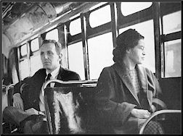
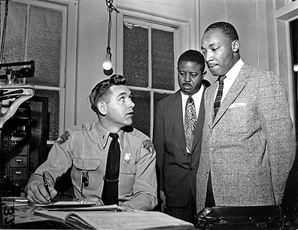
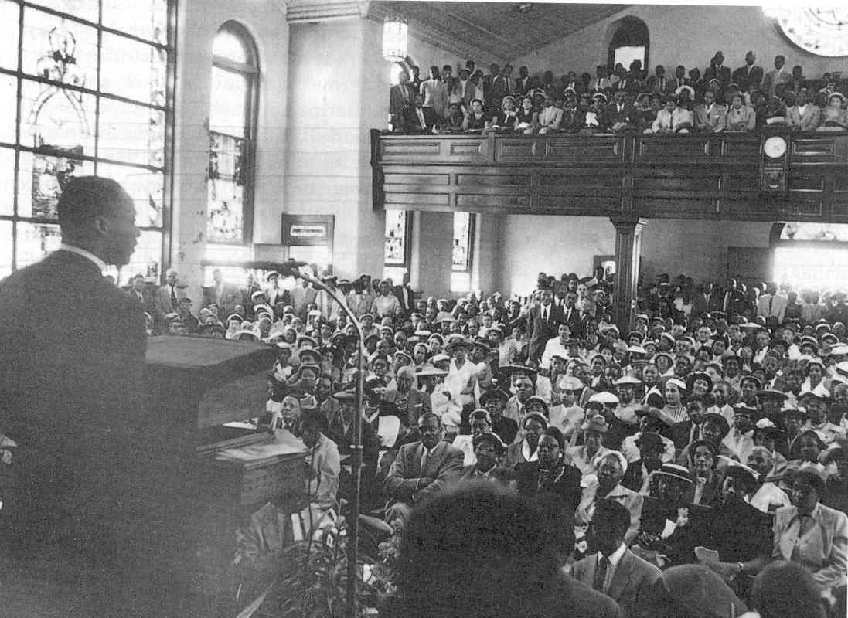
Montgomery Bus Boycott (1955)
Rosa Parks refused to give up her seat on a bus to a white person and was arrested.
Not the 1st person arrested for this
Volunteered at local NAACP office
Black citizens organized a boycott of the bus system.
Rev. Martin Luther King Jr. (MLK) selected to be the leader of the Montgomery Improvement Association and head of the boycott
70% of business came from Blacks
White Citizens’ Council fought MLK’s action
Supported bus company to keep in business
After 381 days, Supreme Court rules segregation on city buses unconstitutional
Rosa Parks
Martin Luther King

Slide 19
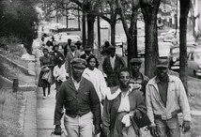
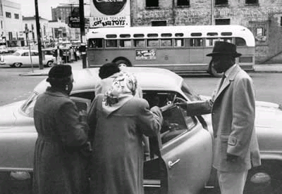
Some walked, while others car pooled during the boycott

Slide 20
Non-Violent Protests during the Civil Rights Movement
Civil rights workers used several direct, nonviolent methods to confront discrimination and racism in the late 1950s and early 1960s.
Boycotts
Sit-ins
Freedom Rides
Many of these non-violent tactics were based on those of Mohandas Gandhi—a leader in India’s struggle for independence from Great Britain.
American civil rights leaders such as James Farmer of CORE, Martin Luther King Jr. of SCLC, and others shared Gandhi’s views.

Slide 21
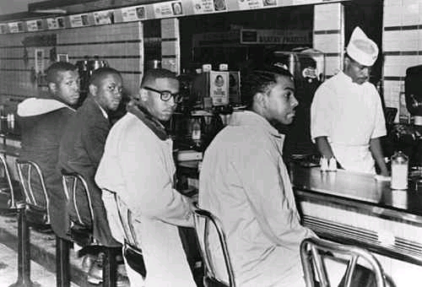
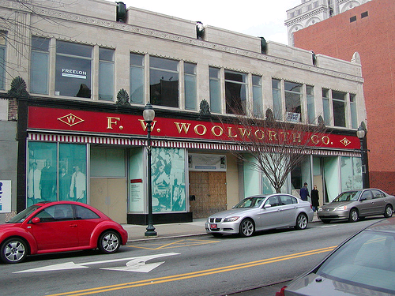
Greensboro, NC Sit-ins (1960-)
Four Black college students were refused service at Woolworth’s lunch counter due to their skin color
They refused to leave their seats at a segregated lunch counter
More joined in protest in next few days
63 of 66 seats being filled with protestors
Ended protests with daily prayers
Dilemma: serve blacks and they win or refuse and you lose business
After this succeeded, this became a popular tactic throughout the South.

Slide 22
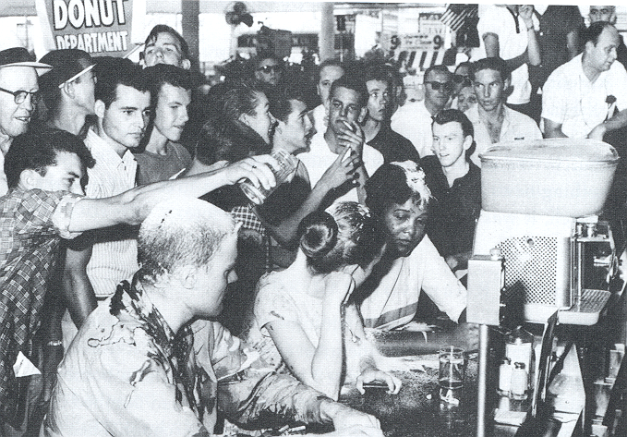
Primary Sources-Photographs

Slide 23
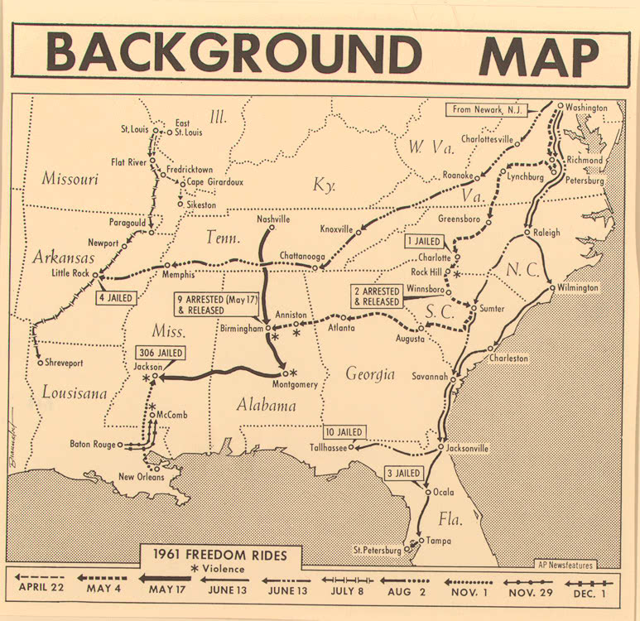
Freedom Rides (Spring 1961)
Supreme Court in 1960 ordered that bus station facilities for interstate travelers must be open to all passengers.
Members of CORE and SNCC wanted to test compliance with court decision
Chartered a Greyhound bus
Trip from Washington D.C. to New Orleans.
Mobs angry at the Freedom Riders attempts to use white-only facilities firebombed a bus in Anniston, Alabama and attacked riders with baseball bats and metal pipes in Birmingham.

Slide 24
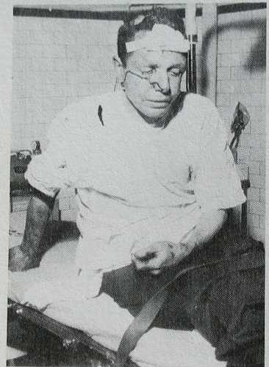
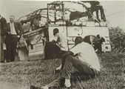
Results:
President John F. Kennedy and Attorney General Robert Kennedy order federal marshals to Montgomery to protect the riders.
The Interstate Commerce Commission finally forced the integration of bus and train stations.

Slide 25
The Albany Movement
The Movement
SNCC began a sit-in in Albany’s bus station.
Over 500 demonstrators were arrested.
The federal government was informed but took no action.
Local leaders asked Martin Luther King Jr. to lead more demonstrations and to gain more coverage for the protests.
He agreed and was also arrested.
The Results
The police chief had studied King’s tactics and made arrangements to counter-act the nonviolent protest.
When the press arrived, King was released.
City officials would only deal with local leaders until King left.
Once King left, officials would not negotiate at all.
The nine-month movement failed.

Slide 26
Birmingham, Alabama (1963)
Considered most racist, segregated large city in the South
Nicknamed Bombingham due destruction of Black businesses, churches, and homes with dynamite
Martin Luther King raised money to fight Birmingham’s segregation laws.
Volunteers began with sit-ins and marches and were quickly arrested along with King
Fewer African Americans were willing to join and risk their jobs.
White clergy attacked King’s actions in a newspaper ad.
King wrote his “Letter from a Birmingham Jail.”
Devises “Project C”
Large scale non-violent confrontation using children to help draw media attention and public sympathy from around the world
Highly effective

Slide 27
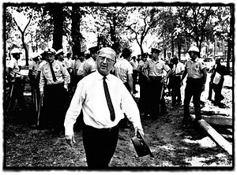
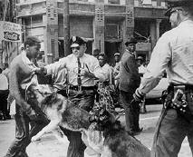
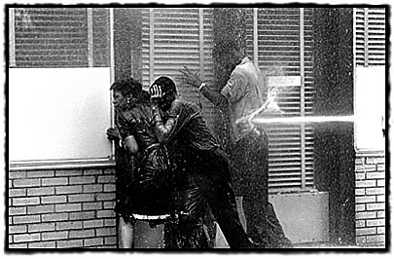
Birmingham, Alabama (1963)
More than 900 children between ages six and eighteen were arrested.
Police Chief Eugene “Bull” Connor used police and fire fighters to break up a group of about 2,500 student protesters.
The violence of Connor’s methods was all over the television news.
Attitudes shifted against Southern efforts to maintain segregation
Federal negotiators got the city officials to agree to many of King’s demands.

Slide 28
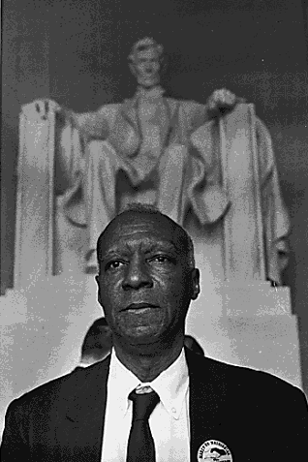
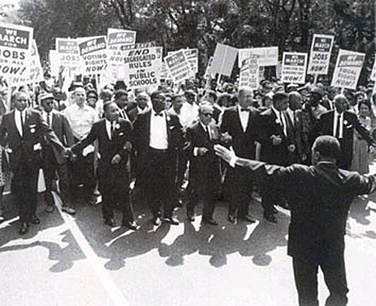
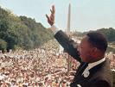
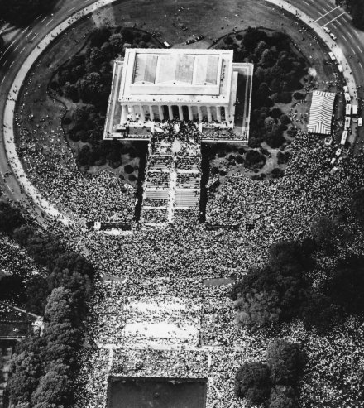
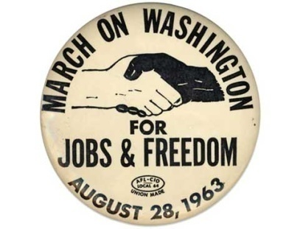
March on Washington (1963)
Site of MLK’s famous “I have a dream” speech.
1st proposed by A. Phillip Randolph
~250,000 people gathered peacefully to lobby Congress and show support for John F. Kennedy’s civil rights legislation.
Kennedy asked King to postpone for fear of violence
King refused

Slide 29
Civil Rights Act of 1964
The events in Birmingham, Alabama convinced President Kennedy to act on civil rights issues.
Kennedy announced that he would ask for legislation to finally end segregation in public accommodations.
Assassinated by Lee Harvey Oswald 11/22/63 for reasons unclear. Oswald shot and killed next day by a local bar owner and known mob associate Jack Ruby
President
Kennedy
Medgar Evers, the head of the NAACP in Mississippi, was shot dead in his front yard.
Ku Klux Klan member Byron De La Beckwith was tried for the crime but all-white juries failed to convict.
Medgar
Evers
On August 28, 1963, the largest civil rights demonstration ever held in the United States took place in Washington.
More than 200,000 people marched and listened to Martin Luther King Jr.’s “I Have a Dream” speech.
March
on
Washington

Slide 30
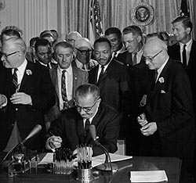
Passing the Civil Rights Act
President Johnson supported passage of a strong civil rights bill.
Played sympathy card
Used Kennedy’s death to gain support
Some southerners in Congress fought hard to kill his bill.
Johnson signed the Civil Rights Act of 1964 into law on July 2, 1964.
The law banned discrimination in employment and in public accommodations.

Slide 31
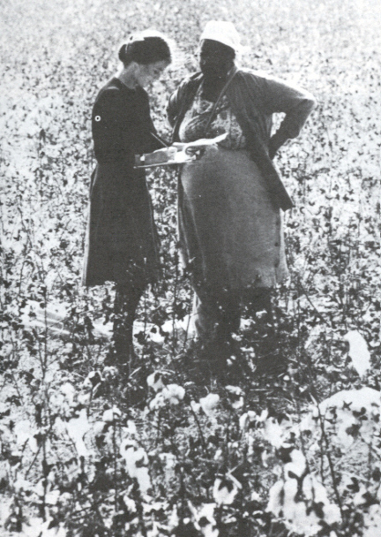
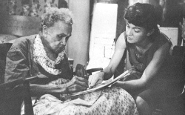
Gaining Voting Rights for African Americans in the South
President Kennedy was worried about the violent reactions to the nonviolent methods of the civil rights movement.
Attorney General Robert Kennedy urged SNCC leaders to focus on voter registration rather than on protests.
He promised that the federal government would protect civil rights workers if they focused on voter registration.
Hundreds of people volunteered to spend their summers registering African Americans to vote.

Slide 32
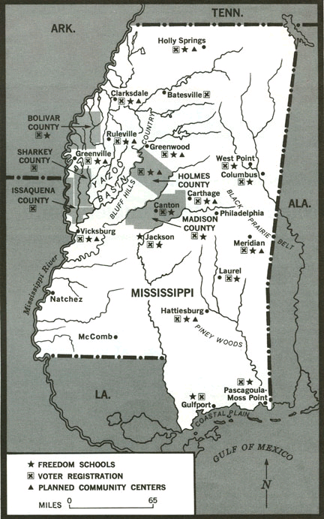
Freedom Summer (1964)
Less than 7% registered prior
Lowest in country
Campaign to register Blacks in Mississippi to vote known as Freedom Summer
Opened Freedom Schools and Community Centers
Taught core reading and math classes along with civics
Provided free medical and legal assistance
Arrival of hundreds of volunteers was met with massive violence.
CORE, NAACP, and SNCC efforts

Slide 33
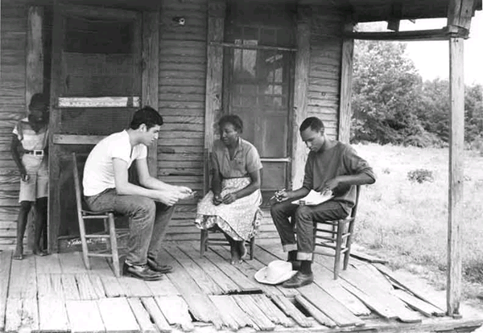

Slide 34
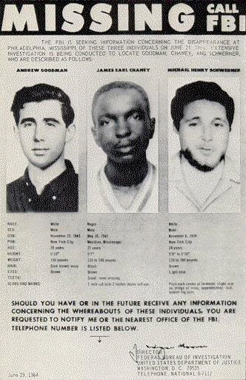
Tragedy in Mississippi
James Chaney, and his white coworkers, Andrew Goodman and Michael Schwerner disappear
Search is on
Presumed dead
Robert Moses, Mississippi director of SNCC offers workers a chance to go home
Over 90% stay to work on project
President Johnson urges full FBI investigation
Slain bodies found 6 weeks later

Slide 35
Results
Judge Cox imposed sentence on December 29, 1967.
Price and Posey received six years.
Roberts and Bowers received ten years.
All others received four years.
In regards to his sentences, "They killed one nigger, one Jew, and a white man -- I gave them all what I thought they deserved." –Judge Cox
Significance of Freedom Summer:
First time jury finds whites guilty of civil rights violation
Almost 500,000 new Black voters in South
Helps get Johnson re-elected

Slide 36
Voting Rights Grow
Voting Rights Act of 1965 | 24th Amendment
Passed by President Johnson Federal officials could register voters in states where discrimination continued More than one million blacks are registered to vote in the South by 1968. | Outlawed poll taxes in national elections

Slide 37
Most vote Democrat
Loyalty to the party that has supported civil rights the most
President Kennedy, Attorney General Robert Kennedy and President Johnson

Slide 38
Fractures in the Movement
Black Power
Stokely Carmichael became the head of SNCC.
SNCC abandoned the philosophy of nonviolence.
Black Power became the new rallying cry.
Wanted African Americans to depend on themselves to solve problems.
Black Panthers
The Black Panther Party was formed in Oakland, California, in 1966.
Co-founders: Huey Newton and Bobby Seale
Called for violent revolution as a means of African American liberation.
Members carried guns and monitored African American neighborhoods to guard against police brutality.
Black Muslims
Nation of Islam was a large and influential group who believed in Black Power.
Elijah Mohammed founded
Message of black nationalism, self-discipline, and self-reliance.
Malcolm X offered message of hope, defiance, and black pride.

Slide 39
Call for Black Power
Coined by Stokley Carmichael (SNCC)
Encouraged pride in heritage:
“Black is beautiful”
Grew large afros
Afro- American studies
Use of African names
Symbolized by raised fist
Threatening to whites

Slide 40
1968 Mexico City Summer Olympics
Black Power on world stage
Caused controversy
American track and field stars: Tommie Smith and John Carlos politicize awards
200m dash medal ceremony

Slide 41
Malcolm X
Views totally different from Martin Luther King
“meet violence with violence”
supported separatism over
integration
Kicked out of the Nation of Islam by Elijah Mohammed ‘63
Softened stance about White race
Saw many good White people on religious pilgrimage
Less outspoken of MLK
Assassinated in 1965 in Harlem
Probably by members of Nation of Islam
Born--Malcolm Little; becomes Malcolm X

Slide 42
Black Muslim Strategy
Seek youthful stars that through their popularity and fortune can help support group
Converts cast aside given name and adopt new Muslim name
Famous examples:
Cassius Clay/Muhammad Ali
Lew Alcindor/Kareem Abdul-Jabbar
Bobby Moore/Ahmad Rashad

Slide 43
Black Panthers
Also provided social services for community like day-care, free breakfast program and after-school programs in Afro-Centric education
Co-Founders: Bobby Seale (left) and Huey Newton (right)

Slide 44
The Death of Martin Luther King Jr.
King became aware that economic issues must be part of the civil rights movement.
King went to Memphis, Tennessee to help striking sanitation workers. He led a march to city hall.
Site of famous “Mountaintop” speech
James Earl Ray shot and killed King as he stood on the balcony of his motel.
Within hours, rioting erupted in more than 120 cities. Within three weeks, 46 people were dead, some 2,600 were injured, and more than 21,000 were arrested.
Presidential candidate Robert Kennedy able to keep people calm in Indianapolis
Robert Kennedy assassinated 2 months later by Sirhan Sirhan

Slide 45
Riots
Frustration over poverty, slow change, and police treatment.
Inner-city ghettos erupt in violence with small spark
“burn baby burn” to prove a point
Rochester and NYC in 1964
Watts in 1965
Detroit in 1967
Many other cities after the assassination of MLK in 1968
Riots set cities back for decades as businesses destroyed were rebuilt elsewhere, people moved away, and damage not cleaned up in timely fashion

Slide 46
Legacy of the Movement
1st African-American president of the United States
African-Americans move into political positions in many states and big cities.
Gains made inspired other minority groups to stand up for their rights: Women, Hispanics, Gays, etc.
all of these groups have made significant strides for their cause in recent years. Many have used techniques similar to those of the civil rights movement of the 1950’s and 60’s.

