Slide 1
Isolationism and Neutrality

Slide 2
Isolationism and Neutrality
Isolationism – Neutral with no trade
Nation’s foreign policy calls for neither economic nor political ties with other countries
Neutrality – Neutral with trade
Nation’s foreign policy calls for not taking sides in any international argument, controversy, dispute, or war
International trade is okay, so long as it does not involve picking sides in a dispute

Slide 3
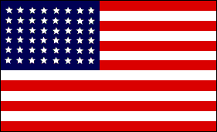
Historical Background
George Washington
Proclamation of Neutrality, 1793
No U.S. involvement or aid in the French Revolution
Farewell Address, 1796
U.S. should avoid “entangling alliances”
James Monroe
Monroe Doctrine, 1823
U.S. would leave Europe alone, and Europe should leave the Western Hemisphere alone

Slide 4
But, what about all these wars since?
War with Mexico, 1846
Spanish – American War, 1890s
The Great War, 1916-1919 (aka WWI)
WWII, 1941-1945

Slide 5
Imperialism
When Americans truly believed in concepts like Manifest Destiny and White Man’s Burden, wars were essentially about colonization, conquest and natural resources
But, to sum up it is always been about
PROTECTING AMERICAN INTERESTS

Slide 6
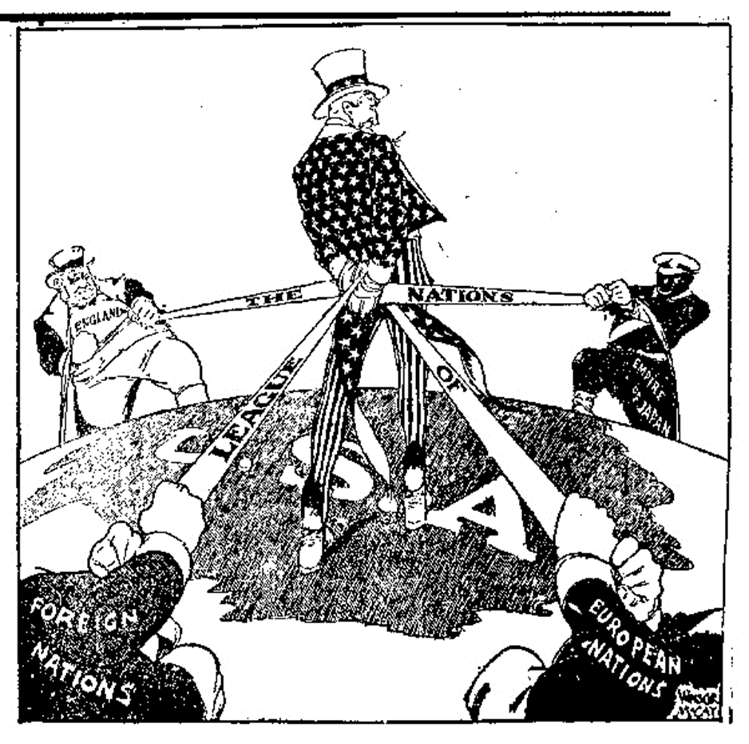
Popular Opinion
But even still, Americans have never liked becoming entangled into other countries’ affairs.

Slide 7
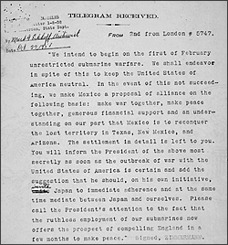
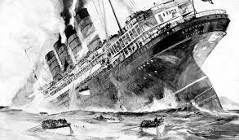
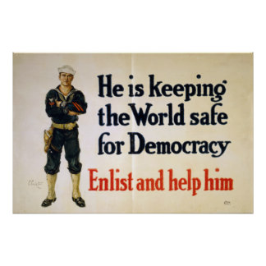
WWI

Slide 8
Aftermath of WWI
The First World War, also known as the “Great War” or the “War to End All Wars,” was global war.
Battles were fought in the trenches using machine guns, poisonous gas and tanks
Battles were fought at sea and coastal towns were shelled by German warships
Planes were used for battle and for positioning and reporting on the enemy
Battles were fought by air with many air raids by German Zeppelins
Civilian workers produced weapons, munitions, equipment and supplies for the troops
Medical personal ministered to the hundreds of thousands of wounded, maimed and sick
Red Scare grips America at home
Allied Countries - Losses:
Military Casualties: 5.7 million
Civilian Casualties: 3.67 million
Military Wounded: 12.8 million

Slide 9
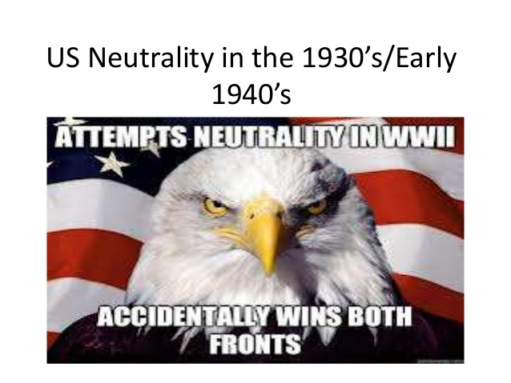
WWII
We really do try to stay neutral

Slide 10
WWII
Neutrality Act 1935 –
Neutrality Acts 1939 –
Cash & Carry
Lend-Lease Act
Atlantic Charter

Slide 11
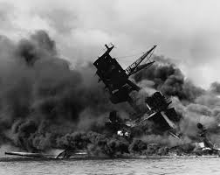
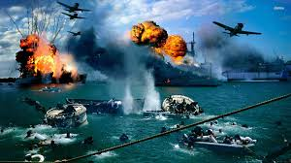
WWII

Slide 12
After WWII
Another Red Scare
Americans say “no more wars…Buuutttt we hate communism more.”
Monroe Doctrine is out
Eisenhower and Truman Doctrines are in

