Slide 1
MONROE DOCTRINE

Slide 2
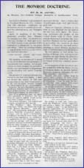
Background
In foreign affairs James Monroe proclaimed the fundamental policy that bears his name, Monroe Doctrine.

Slide 3
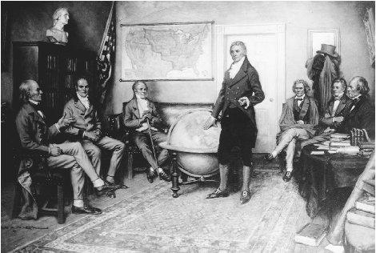
Background
Monroe & his Sec. of State, JQ Adams wanted to protect new republics in western hemisphere from outside threats

Slide 4
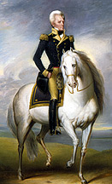
Background
Monroe was responding to the threat that Europe might try to aid Spain in winning back her former Latin American colonies.
(Florida issues, Adams-Onis Treaty)

Slide 5
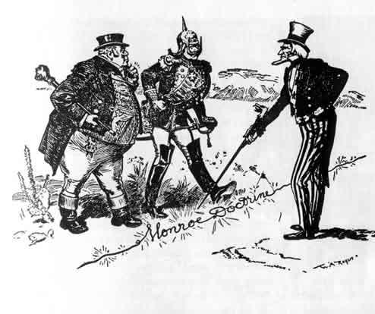

Slide 6
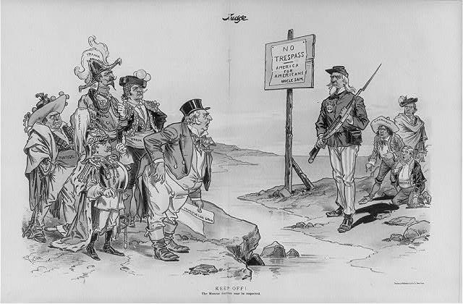

Slide 7
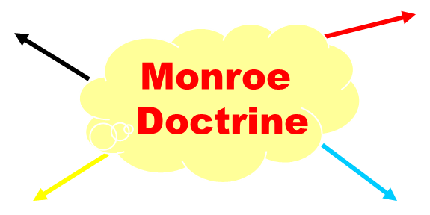
Monroe Doctrine in a nutshell
Referred to as America’s Self Defense Doctrine.
It is a continuation of President Washington’s neutrality and isolationist policies.
Past problems with Europe led the US to declare the Americas off-limits to Europe
US was now the protector of new democracies in the Western Hemisphere
No European Colonization allowed in the Americas
US was now the protector of new democracies in the Western Hemisphere
No European Colonization allowed in the Americas

Slide 8
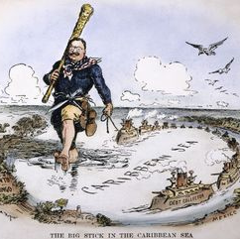
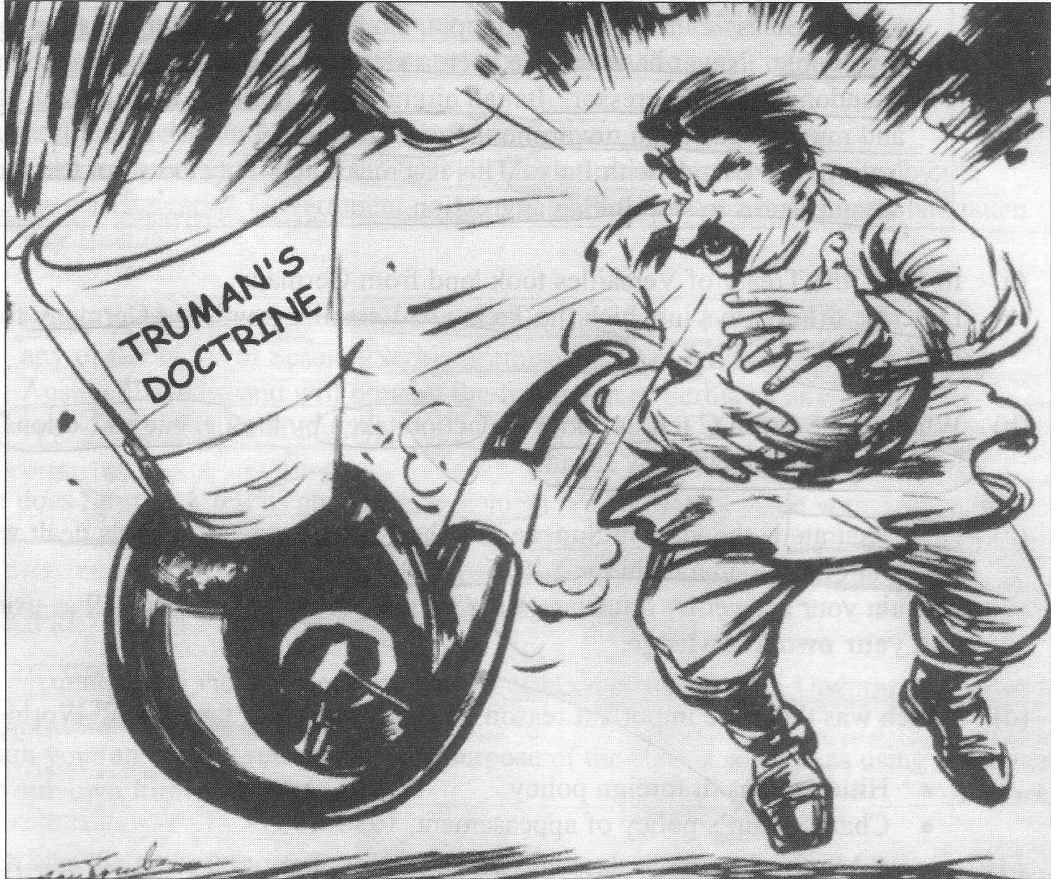
Other Ways We Have Applied This Policy
Roosevelt Corollary
Truman Doctrine (kinda)

Slide 9
Extending the Doctrine
1842 - Tyler applies the doctrine to Hawaii in what would later be viewed a bad move.
1845 - Polk used the Monroe doctrine to support his case for manifest destiny.
1852 - the Monroe doctrine was used in an attempt to force Spain out of Cuba.
1862 - Napoleon III invades Mexico; the US sees this as a violation of the doctrine but due to involvement in the Civil War can do nothing about it.
In the 1870’s Grant attempts to replace European influence with the US in Latin America.

Slide 10
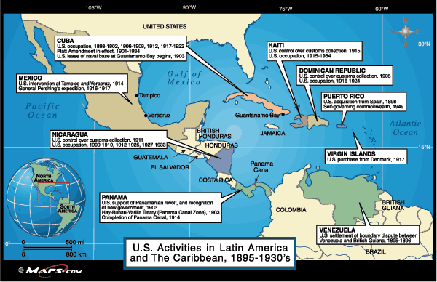
Roosevelt Corollary
Added in 1904
The corollary states that the US has the right to interfere in disagreements between Latin America and European powers as an arbitrator

Slide 11
Truman Doctrine
If the goal of Monroe was to remain OUT OF European Affairs, the Truman Doctrine completely negates that.
This was our way of justifying interference in Europe and Asia
All for the sake of…

Slide 12
CONTAINMENT!!!

