Slide 1
Reconstructing Society
What about the slaves?

Slide 2
13th Amendment
“Neither slavery nor involuntary servitude, except as a punishment for crime whereof the party shall have been duly convicted, shall exist within the United States, or any place subject to their jurisdiction”.
When is the only time you can be forced to work?

Slide 3
Freedmen’s Bureau
This first relief agency in the US
Showed a real concern for the freedmen by many in government
Job training
Living assistance
Not enough support from congress to make long lasting changes

Slide 4
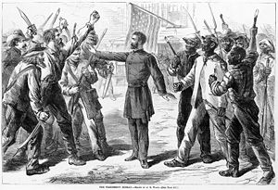

Slide 5
Black Codes
Many states used laws called “black codes” to force free blacks into a position not too different from slavery
Many states used legal “loopholes” to deny constitutional rights to African Americans
This contradicted what the constitution said but they got away with it

Slide 6
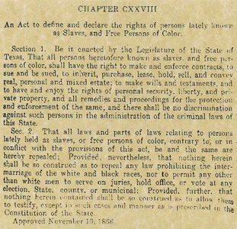

Slide 7
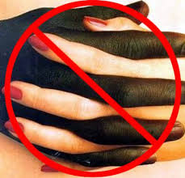
Black Codes
Curfews- blacks could generally not gather after sunset
Vagrancy- could be jailed or whipped for not working.
Labor contracts- agreements to work for a year with harsh consequences
Land restriction- could only live in certain areas
Miscegenation laws- no “intermingling” of he races

Slide 8
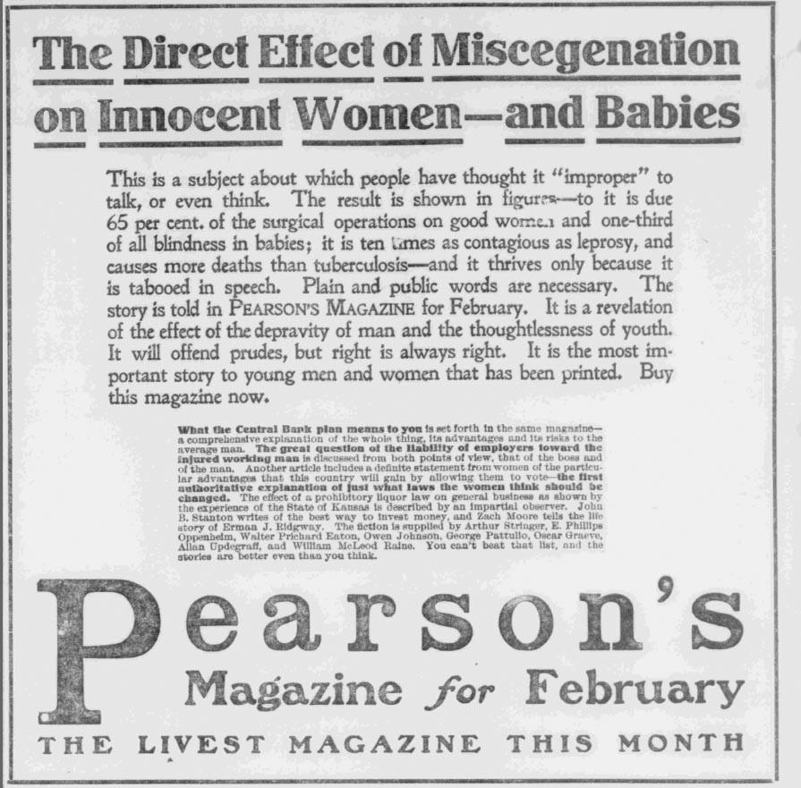

Slide 9
14th Amendment
Citizen= anyone born or naturalized in USA
Guarantees due Process of the law
Guarantees equal Protection of the law
Still the most important Civil Rights amendment ever passed

Slide 10
Violence Against Blacks
As Congressional Reconstruction begins to breakdown things are harder to control
Riots occur in many cities (including NY)
Police often participated in the riots by stabbing, shooting and hanging blacks

Slide 11
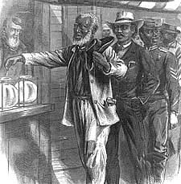
15th Amendment
The 15th Amendment allows all people (men) to vote regardless of skin color or previous “condition of servitude”.
In 1870 more than 600 African Americans elected to office
In 1874 Mississippi sent a former slave to the senate
Hiram Revels

Slide 12
Voting Loopholes
Poll Taxes- a tax paid to vote or a requirement to own land to vote
Literacy Tests- a test to see who is “fit” to vote
Grandfather Clauses- if your grandpa voted in 1860 so can you
Why would they add this?

Slide 13
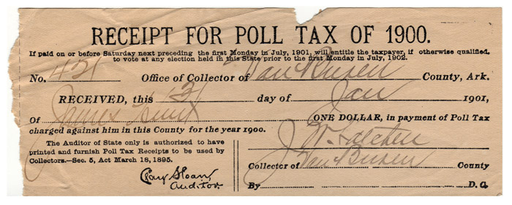

Slide 14
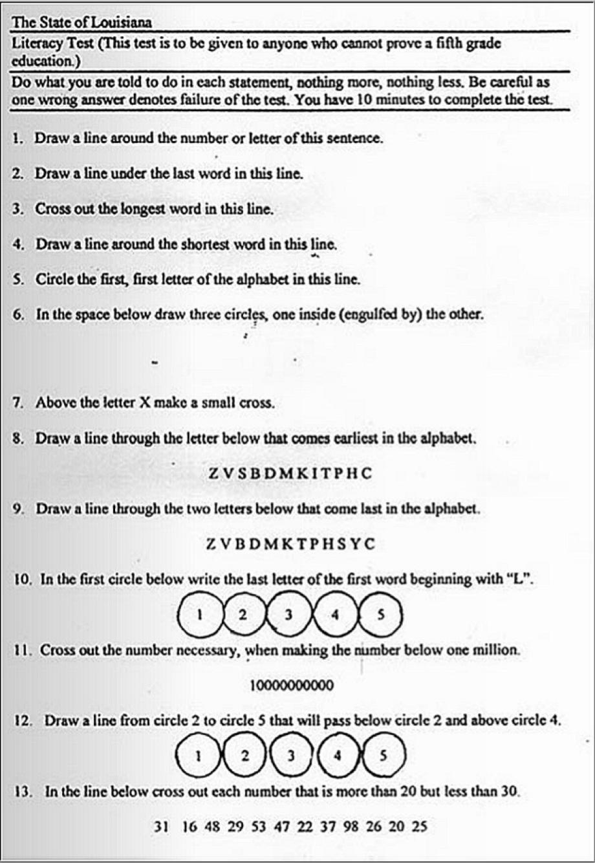

Slide 15
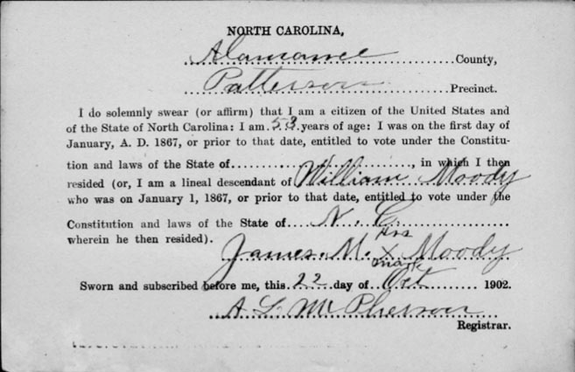
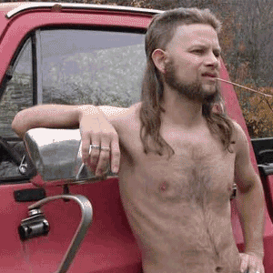

Slide 16
Racial Violence Spreads
KKK starts in 1866
Starts to intimidate blacks and southern republicans
Membership consisted of ex-confederates
Congress and the courts arrested and tried thousands of Klansmen in response

Slide 17
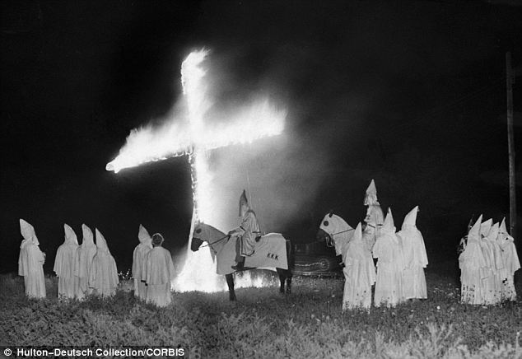
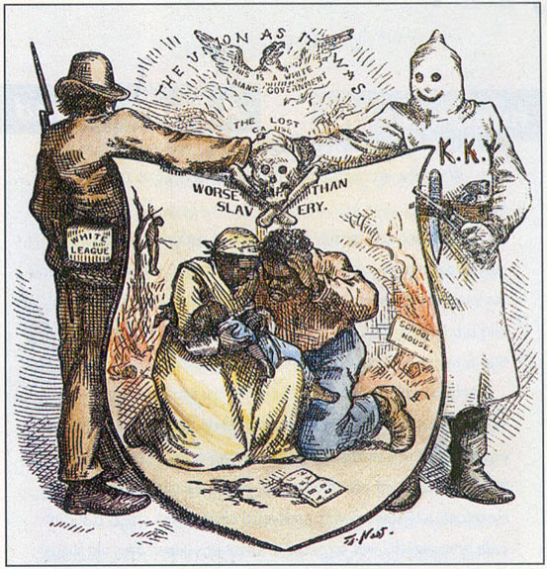
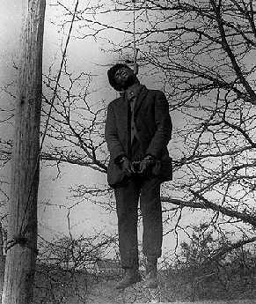

Slide 18
The “New South”
A lot like the Old South

Slide 19
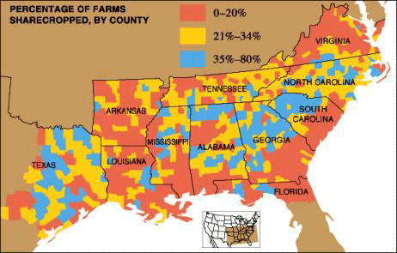
Share Cropping
Families farmed a portion of a planters land
Payment was a share of the crop at harvest time
The planter usually provided Housing

Slide 20
Problems with Sharecropping
You could be fined for missing a single day
Many charged the families high rates for housing and other expenses
Farmers ended up it debt and couldn’t leave till it was paid
Every year the debt got bigger
Now they are forced to work and can’t leave

Slide 21
Tenant Farming
They paid rent to work a plot of land
They chose what to plant and had a higher social status
New merchants spring up in the south to supply tenant farmers (usually on credit)

Slide 22
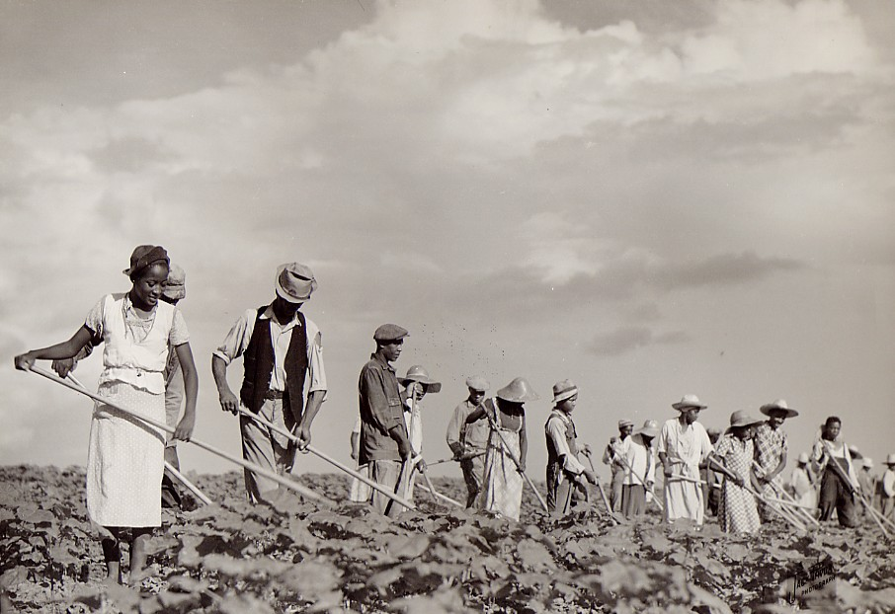
Problems with Tenant Farming
Like share cropping tenant farmers fall prey to greedy landlords
Many merchants charge them high interest

Slide 23
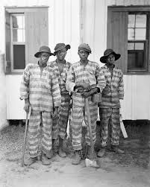
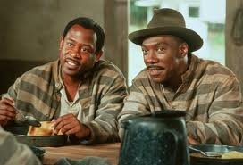
Southern Prisons
13th Amendment “Neither slavery nor involuntary servitude, except as a punishment for crime whereof the party shall have been duly convicted, shall exist within the United States, or any place subject to their jurisdiction”.

Slide 24
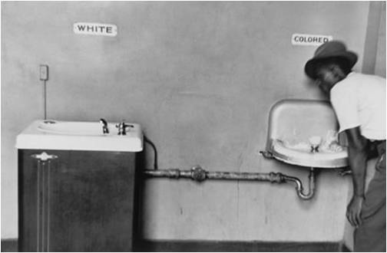
Plessy Ferguson
Established the idea of SEPARATE BUT EQUAL.
This creates conditions to make all black codes permanent
JIM CROW laws- the unequal separation of black and white society in the south.

Slide 25
Reconstruction
What about it was a success?
What about it was a failure?

