Slide 1
Reconstruction
(1865-1876)

Slide 2
Issues at Hand
How do you integrate the Southern states back in the Union???
What do you do with Freedmen?

Slide 3
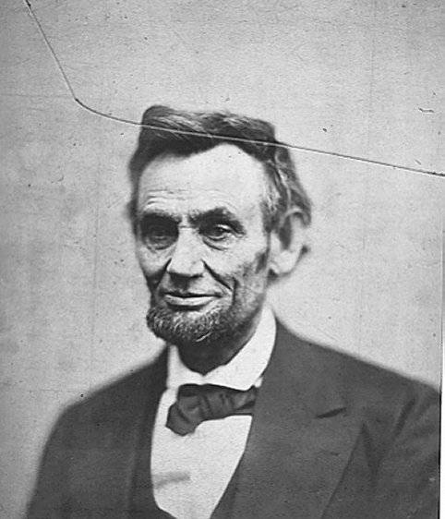
President Lincoln’s Plan
10 % Plan
Lenient to South
10% swear allegiance
allow Southerners to
retain their property
and reacquire their
political rights

Slide 4
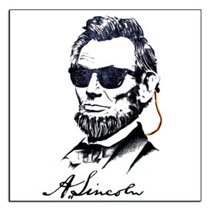
President Lincoln’s Plan
1864 → “Lincoln Governments” formed in LA, TN, AR
“loyal assemblies”
They were weak and dependent on the Northern army for their survival

Slide 5
Failures on Lincoln Plan
Black Codes
Economic hardships facing freedmen
Refusal to ratify 14th Amendment
Support for Radical Republicans
Notes:
Black Codes: Many states passed laws restricting the rights of freedmen
Little attempt was made to address the economic hardships facing freedmen
Southern States admitted under Lincoln/Johnson plan refused to ratify 14th Amendment
These failures contributed to growing support for Radical Republicans

Slide 6
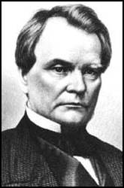
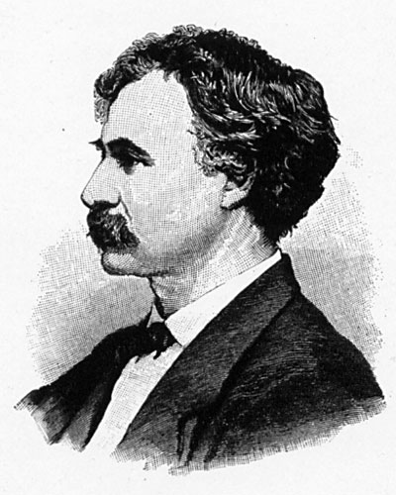
Wade-Davis Bill (1864)
Required 50% of the number of 1860 voters to take an “iron clad” oath of allegiance
Required a state constitutional convention.
Enacted specific safeguards of freedmen’s liberties.
Senator Benjamin Wade (R-OH)
Congressman Henry W. Davis (R-MD)
Notes:
(swearing they had never voluntarily aided the rebellion ).
Required a state constitutional convention before the election of state officials

Slide 7
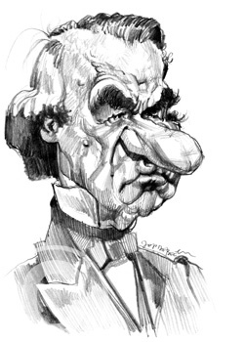
JOHNSON’S PLAN
He excluded high ranking Confederates and wealthy planters from the oath,
“White men alone must manage the South”
Notes:
After Lincoln’s death, his VP & successor Andrew Johnson announced his own plan
It differed only slightly from Lincolns: He excluded high ranking Confederates and wealthy planters from the oath, but did pardon 13,000 while contending that “White men alone must manage the South”

Slide 8
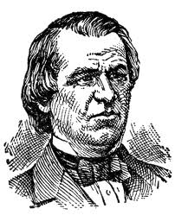
Failures on Lincoln Plan
Black Codes
Pardoned 13,500 Confeds.
Refusal to ratify 14th Amendment
Support for Radical Republicans
Notes:
Black Codes: Many states passed laws restricting the rights of freedmen
Little attempt was made to address the economic hardships facing freedmen
Southern States admitted under Lincoln/Johnson plan refused to ratify 14th Amendment
These failures contributed to growing support for Radical Republicans

Slide 9
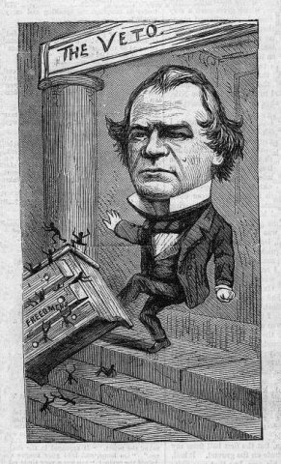
CONGRESS PLAN
Civil Rights Act,
Freedmen’s Bureau Act
14th Amendment
Reconstruction Act - 1867
Congress overrode Johnson’s veto of Freedmen’s Bureau
Notes:
Congress worked hard to shift the focus of Reconstruction from the President to the Congress
Believed the South should be punished for starting the war and hoped to protect the rights of Freedmen (former slaves).
Extended the Freedmen's Bureau (Over Johnson's Veto) to provide food, clothing, shelter, and education to freedmen and war refugees.
Civil Rights Act of 1866 (Passed over Johnson's Veto) designed to grant freedmen full legal equality, undercutting the Black Codes
Reconstruction Act of 1867 (Passed over Johnson's Veto)
Divided the South into 5 districts and placed them under military rule (disbanded governments readmitted under Lincoln/Johnson plans
Required S. States to ratify the 14th Amendment
Guaranteed freedmen the right to vote in conventions to write new state constitutions
15th Amendment

Slide 10
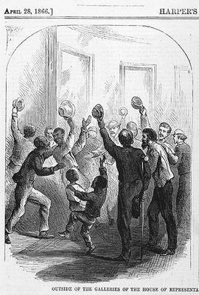
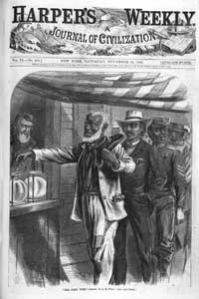
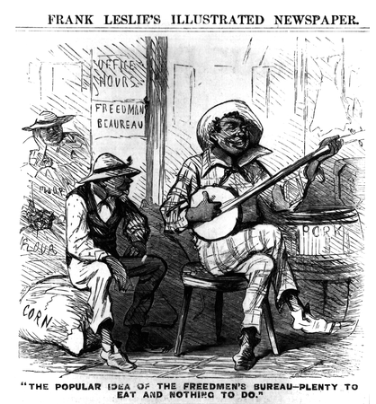
Notes:
Reconstruction Amendments
13th:Amendment: Abolished Slavery
14th Amendment:
Declared all person "born or naturalized in the United States" to be citizens.
Required "Equal Protection of the Laws"
Citizens cannot be denied life, liberty, or property without due process of law.
Reduced the representation in Congress of states that did not grant Black Suffrage
Banned Confederate officials from taking office
Forbade the repayment of confederate War Debt
15th Amendment: The right to vote shall not be denied on the basis of "race, color, or previous condition of servitude"

Slide 11
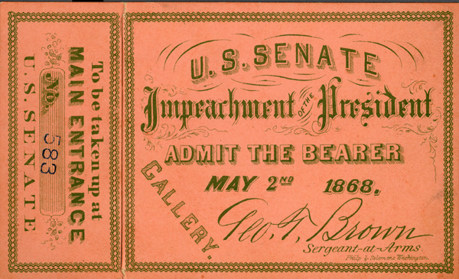
JOHNSON IMPEACHED
Radical Republicans felt Johnson was blocking Reconstruction efforts
Thus, they looked for grounds to impeach him
They found grounds when he fired a cabinet member in violation of the “Tenure of Office Act”
He was impeached, but not convicted and served out his term
GALLERY TICKET FOR JOHNSON IMPEACHMENT HEARING

