Slide 1
Reconstruction
After the Civil War

Slide 2
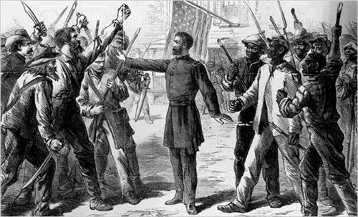
The South Lost But Now What?
What about the damages caused by the war
Do the southern states become part of the US?
What do they have to do?
What about the slaves?

Slide 3
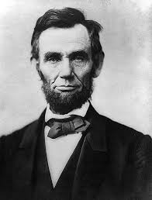
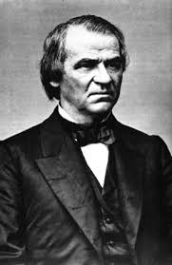
3 plans
Plan 1 Lincoln- 10% plan
Once 10 percent of a states swears loyalty the state can begin working on a constitution an elections
Plan 2 Johnson plan- still the 10% plan
but there were more restrictions to keep the former confederate leaders from regaining power
Both of these guys were republicans but most republicans said they had not done enough in two areas = too week
Punishing the south
Helping the former slaves

Slide 4
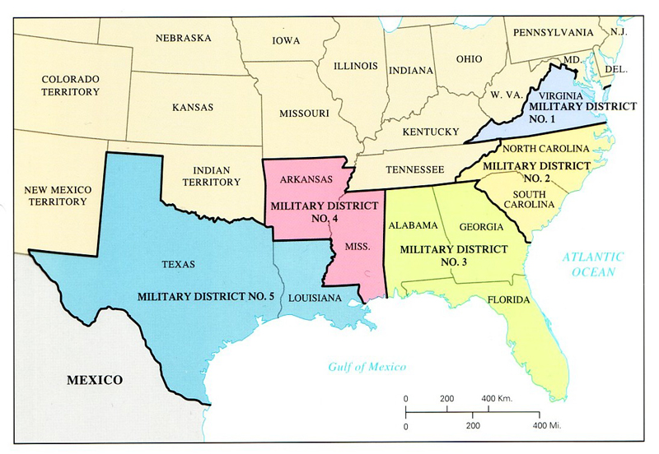
Plan 3
Congressional (radical reconstruction)
Much more aggressive plan
Divides the south into 5 military districts with a northern general in charge
Requires that south ratify the “Civil War” Amendments
Increases the Freedmen’s bureau

Slide 5
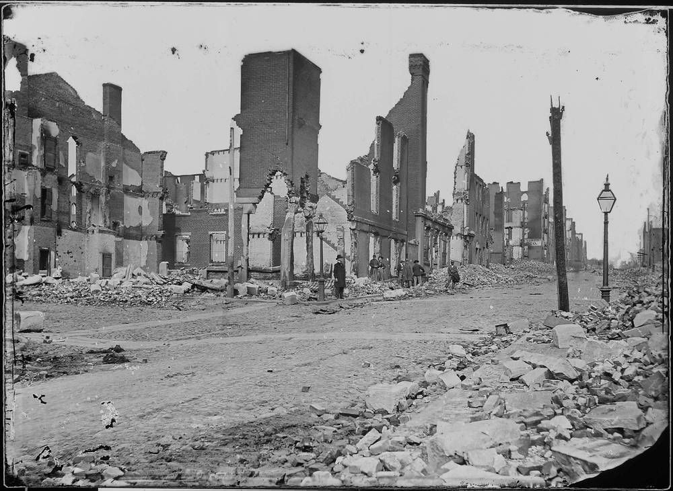
Literally Rebuilding
Many things had to be reconstructed during reconstruction
Railroads
Bridges
Government buildings
Farms
etc.
Government money helped to rebuild the south

Slide 6
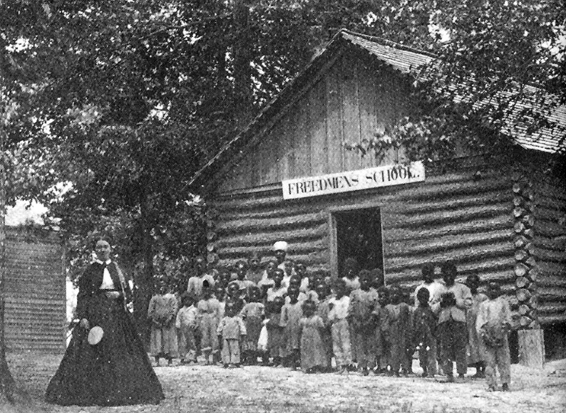
Freedmen’s Bureau
An organization created to help the former slaves improve their condition focusing on two points
Slaves were never allowed to own anything so now free, they have nothing
Slaves were not allowed to read or write so now free, most are illiterate
Provided
Food
Shelter
education

Slide 7
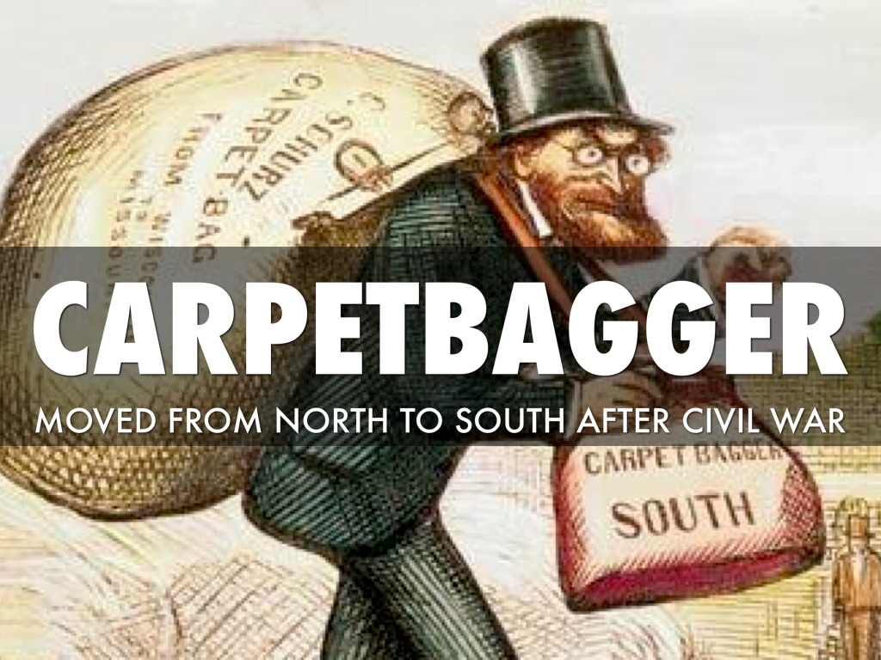
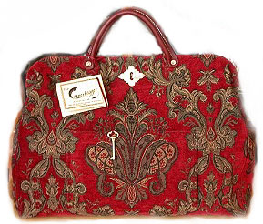
Southern Hatred of Reconstruction
Republicans- Southerners hated them, said they caused reconstruction to happen (Lincoln)
Scalawag- any white southerner who voted republican or sided with reconstruction. It could get you killed
Carpet baggers- Northerners who went to the south to try and take money from reconstruction programs

Slide 8
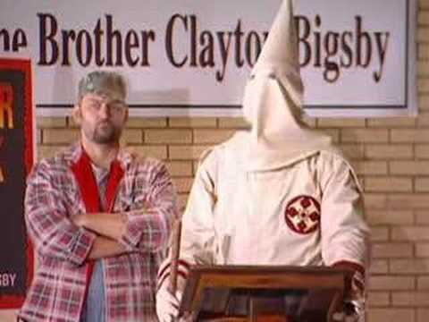
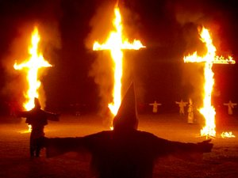
KKK
Originally made up of former confederate officers
It’s main purpose was to keep blacks in a position of inferiority
The law was no longer on their side so they would have to use fear

Slide 9
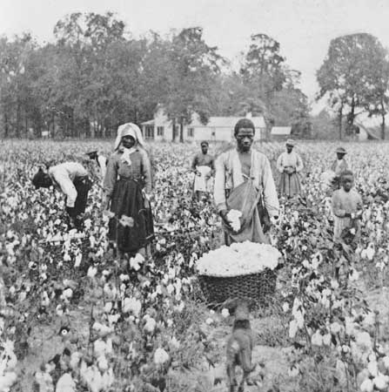
Slavery????
It is outlawed, but little changed
Sharecropping
I own the land
Your work for me
I provide you with home, equipment and food
You pay me out of your profits
YOU CAN NEVER MAKE ENOUGH TO PAY BACK MY RATES!!!!!!!!

Slide 10
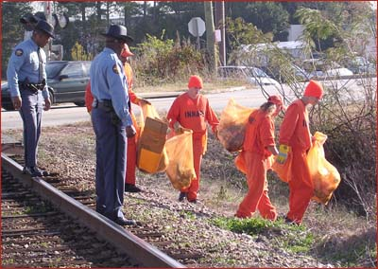
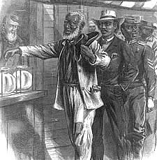
New Rules for AFRICAN AMERICANS (no more slaves)
13th Amendment
outlaws slavery
14th Amendment
Defines a citizen as anyone born in the USA
Guarantees due process equal protection of the law
15th Amendment
Guarantees suffrage to African Americans

Slide 11
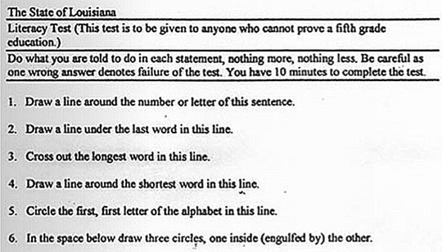
Loopholes
Poll taxes- no $ no vote
Literacy tests- a way to keep former slaves from exercising their rights
Grandfather clauses- away to let poor, illiterate whites vote and still keep poll taxes and literacy tests going.
Black Codes- State laws that were the beginning of legal segregation (before Plessy case)

Slide 12
Success or Failure
success
failure
Southern States are readmitted and the USA continues as one country
Southern infrastructure is rebuilt
Constitutional laws are added
South is still agrarian not industrial
Most freed slaves are stuck in sharecropping
States find loopholes to get out of 13th, 14th, and 15th amendments for black Americans

