Slide 1
The 1950s Domestic Policies
Fear of Communism at Home
Preparation for the Bomb

Slide 2
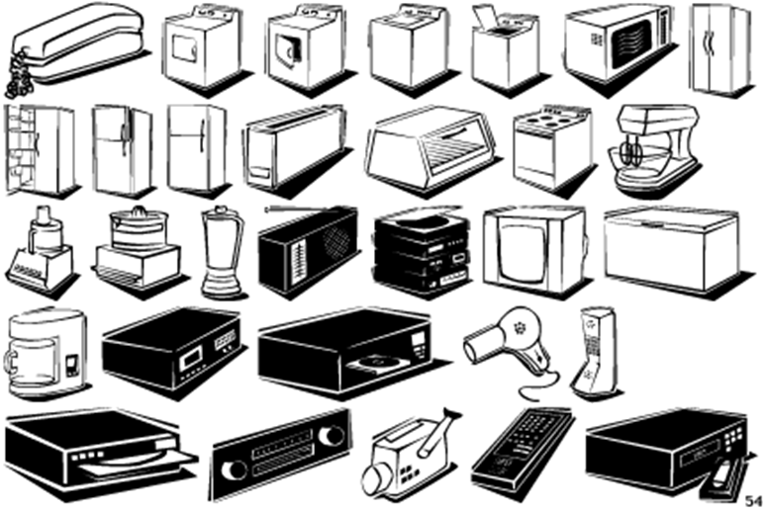
1950s Economy
Return from war;
return to traditional?
Economic Recovery
Truman and Strikes
Notes:
A return to traditional roles after the war was the norm
Men were expected to work, while women were expected to stay home and care for the children
Conflict emerged as many women wanted to stay in the workforce
Divorce rates surged
Experts who predicted a postwar depression were proved wrong as they failed to consider the $135 billion in savings Americans had accumulated from defense work, service pay, and investments in war bonds
Americans were ready to buy consumer goods
One persistent postwar issue involved labor strikes
In 1946 alone, 4.5 million discontented workers, including Steelworkers, coal miners and railroad workers went on strike
Truman refused to let strikes cripple the nation
He threatened to draft the striking workers and then order them as soldiers to return to work
The strategy worked as strikers returned to their jobs

Slide 3
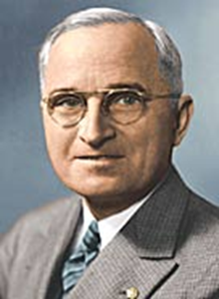
Truman and Social Issues
Notes:
African Americans felt they deserved equal rights, especially after hundreds of thousands served in WWII
Truman took action in 1948 by desegregating the armed forces
Additionally, Truman ordered an end to discrimination in the hiring of governmental employees
Fair deal – extension of New Deal
SS benefits increased, minumum wage increased

Slide 4
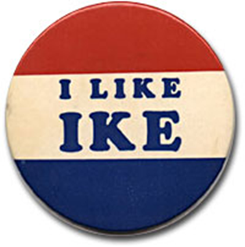
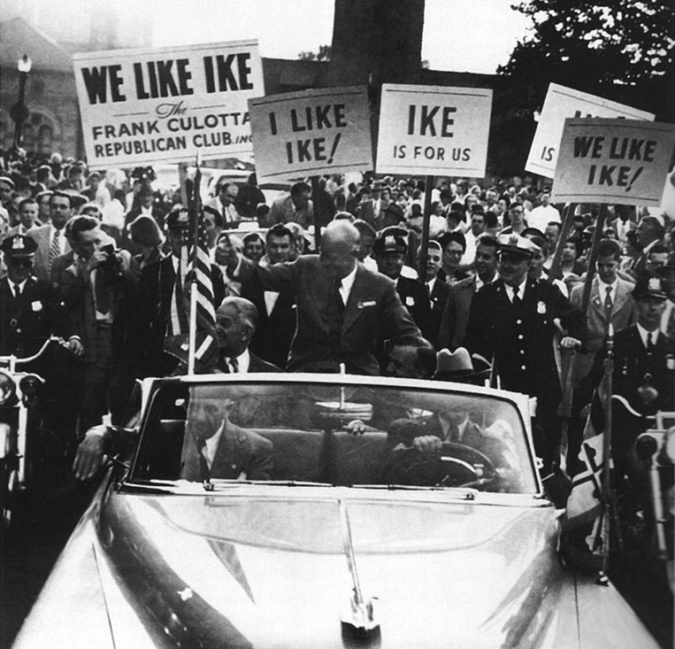
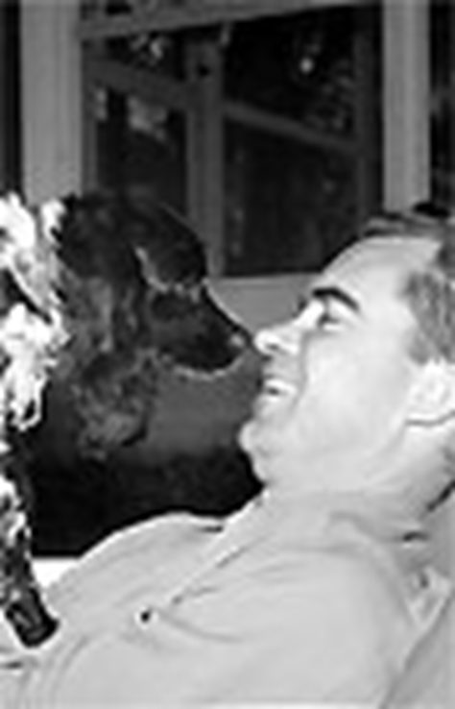
Rise of Ike
Notes:
By 1951 Truman’s approval rating sank to an all-time low of just 23%
Why? Korean War, rising tide of McCarthyism, and a general impression of ineffectiveness
Eisenhower used the slogan, “I Like Ike” for his presidential campaign
Republicans used Ike’s strong military background to emphasize his ability to combat Communism worldwide
One potential disaster for Ike was his running mate’s alleged “slush fund”
Richard Nixon responded by going on T.V. and delivering an emotional speech denying charges but admitting to accepting one gift for his children – a dog named Checkers
The “Checkers speech” saved the ticket

Slide 5
The 3 C’s of the 1950s
Communism

Slide 6
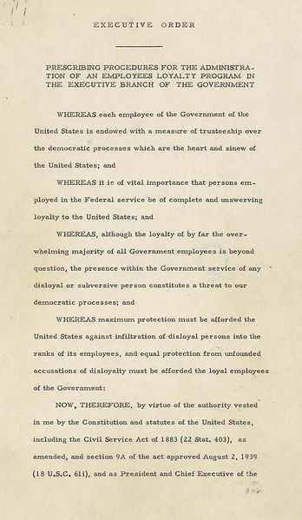
Loyalty Review Board
Executive
Order 9835
Notes:
Investigate gov employees, dismiss those who are unloyal
3.2 million investigates, 202 dismissed, 2900 resigned or quit because of rights violation

Slide 7
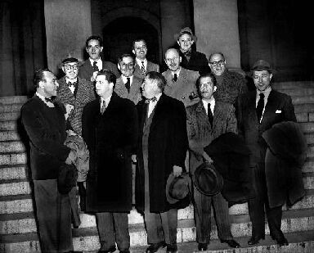
HUAAC
House Un-American
Activities Committee
Hollywood 10
blacklisted
Notes:
Investigate communist threats and activity inside and outside US gov
Film industry
Ten unfriendly actors were called to testify but refused; as a result, sent to prison
Jackie Robinson called before committee ab appeal of communism to blacks
Ronald Reagan

Slide 8
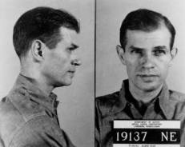
Spy Cases
Notes:
Alger Hiss – accused of spying for soviets; friend claimed Hiss had US documents on a microfilm; typed documents
Nixon pursues him for months; found guilty of perjury but WAS guilty of espionage
Rosenbergs – Ethel and Julius
Soviets got bomb WAY too easy; Klaus Fuchs admits to giving info to Russians
Rosenbergs accused of espoinage and plot for terrorism, sentenced to death

Slide 9
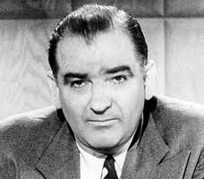
McCarthyism
Notes:
Other anti-commy measures – 39 states passed laws makinit iliiegal to advocate the violent overthrow of the government

Slide 10
McCarthyism
https://www.youtube.com/watch?v=MnUf30oefQw

Slide 11
The 3 C’s of the 1950s
Conformity

Slide 12
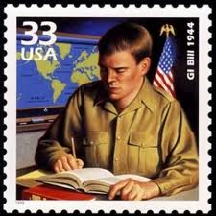
Remember the GI Bill?
Notes:
Education
Unemployment benies while lookin for work
Used money to buy homes

Slide 13
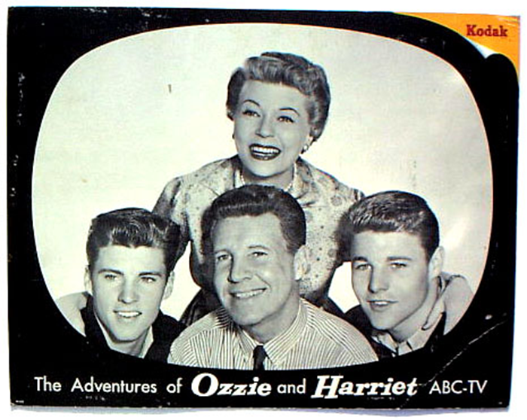
Role of Families; Jobs
Notes:
After WWII ended, Americans turned their attention to their families and jobs
New businesses and technology created opportunities for many
By the end of the 1950s, Americans were enjoying the highest standard of living in the world
During the 1950s, businesses expanded rapidly
More and more people held “white-collar” jobs - clerical, management, or professional jobs
The fields of sales, advertising, insurance and communications exploded
American workers found themselves becoming standardized
Called the “Organization Man,” the modern worker struggled with a loss of individualism
Businesses did not want creative thinkers, rebels or anyone that would “rock the boat”

Slide 14
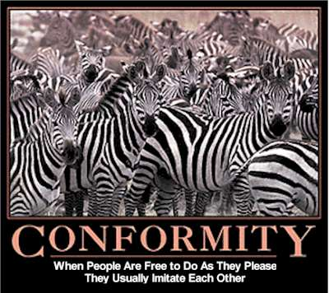
Despite their success, some workers questioned whether pursuing the American dream exacted too high a price, as conformity replaced individuality

Slide 15
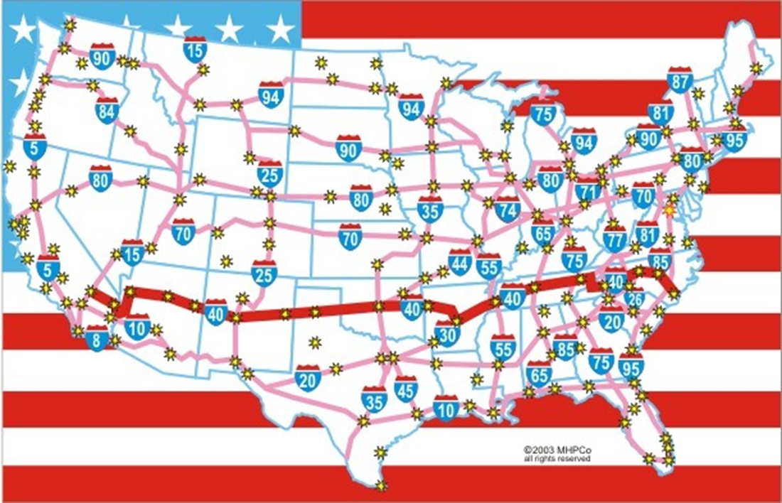
The Automobile Culture
Interstate
Highway Act
Notes:
After the rationing of WWII, inexpensive and plentiful fuel and easy credit led many to buy cars
By 1960, over 60 million Americans owned autos
In 1956 Ike authorized a nationwide highway network – 41,000 miles of road linking America
The Interstate Highway system resulted in:
More trucking
Less railroad
More suburbs, further away
Automania” spurred the construction of roads linking major cities while connecting schools, shopping centers and workplaces to residential suburbs

Slide 16
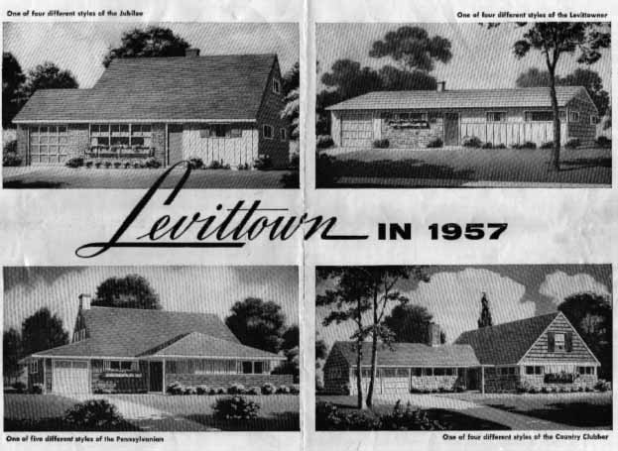
Suburbia
Notes:
Most Americans worked in cities, but fewer and fewer of them lived there
New highways and the affordability of cars and gasoline made commuting possible
Of the 13 million homes built in the 1950s, 85% were built in suburbs
For many, the suburbs were the American Dream
During the late 1940s and through the early 1960s the birthrate in the U.S. soared
At its height in 1957, a baby was born in America every 7 seconds (over 4.3 million babies in ’57 alone)
Baby boomers represent the largest generation in the nation’s history

Slide 17
Impact of Baby Boom
What are the official years of the Baby Boom Generation?
1946 - 1964 saw a marked increase in the number of births in North America.
How did the birthrate rise and fall during the baby boom years in the US?
1940 | 2,559,000 births per year
1946 | 3,311,000 births per year
1955 | 4,097,000 births per year
1957 | 4,300,000 births per year
1964 | 4,027,000 births per year
1974 | 3,160,000 births per year

Slide 18
Perception of Women in the 50s
https://www.youtube.com/watch?v=oay9VxFVFmE

Slide 19
WHITE FLIGHT
In the 1950s, millions of middle-class white Americans left the cities for the suburbs
At the same time millions of African American rural poor migrated to the cities
The so-called “White Flight” drained cities of valuable resources, money and taxes

Slide 20
The 3 C’s of the 1950s
Consumerism

Slide 21
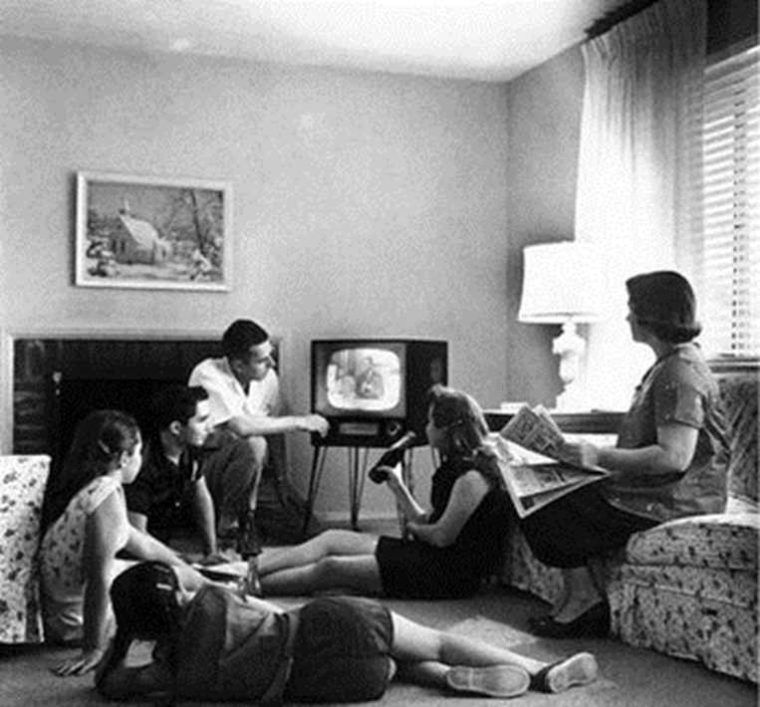
Consumerism
Notes:
One new product after another appeared in the marketplace
Appliances, electronics, and other household goods were especially popular
The first credit card (Diner’s Club) appeared in 1950 and American Express was introduced in 1958
Personal debt increased nearly 3x in the 1950s
The advertising industry capitalized on runaway consumerism by encouraging more spending
Ads were everywhere
Ad agencies increased their spending 50% during the 1950s

Slide 22
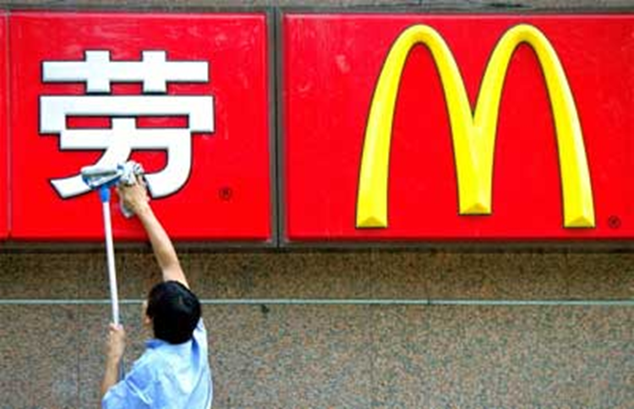
Businesses of the 50s
Notes:
Conglomerates, major corporations that include a number of smaller companies in unrelated fields, emerged in the 1950s
One conglomerate, International Telephone and Telegraph (ITT), bought rental car companies and hotel chains
Another strategy for business expansion was franchising
A franchise is a company that offers similar services in many locations
Fast food restaurants developed the first franchises in America

Slide 23
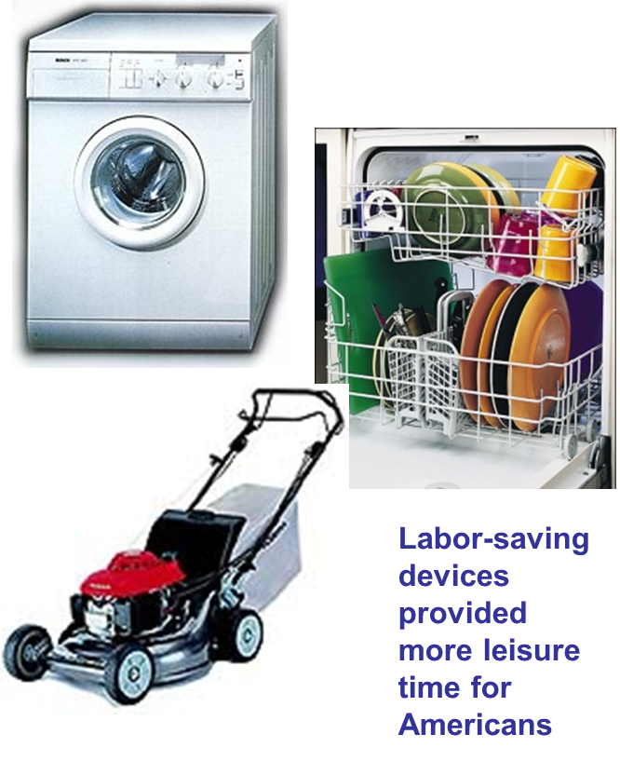
What to do, What to do
Notes:
Americans experienced shorter work weeks and more vacation time than ever before
Leisure time activities became a multi-billion dollar industry
Labor-saving devices added more spare time
In 1953 alone Americans spent $30 billion on leisure
Popular activities included fishing, bowling, hunting and golf
Americans attended, or watched on T.V., football, baseball and basketball games

Slide 24
The Automobile Culture
Interstate
Highway Act
Notes:
After the rationing of WWII, inexpensive and plentiful fuel and easy credit led many to buy cars
By 1960, over 60 million Americans owned autos
In 1956 Ike authorized a nationwide highway network – 41,000 miles of road linking America
The Interstate Highway system resulted in:
More trucking
Less railroad
More suburbs, further away
Automania” spurred the construction of roads linking major cities while connecting schools, shopping centers and workplaces to residential suburbs

Slide 25
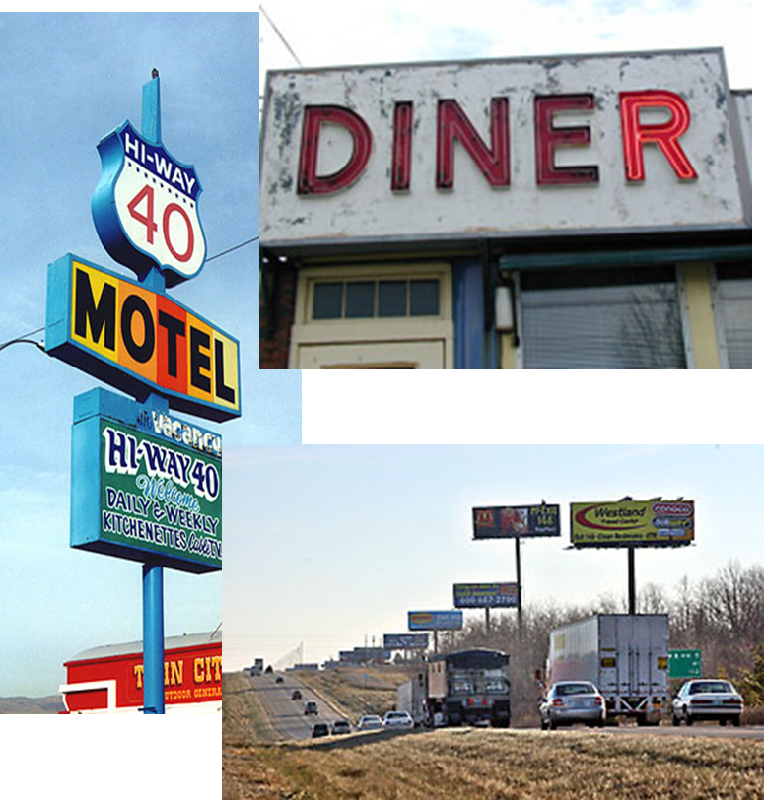
Impact of Automobile
“Homogenous Highways”

Slide 26
CARS
http://www.youtube.com/watch?v=ggtH05LFF3k

Slide 27
Mad Men
https://www.youtube.com/watch?v=C5rQF7Ofc5w

Slide 28
Other PSAs of the 1950s
https://www.youtube.com/watch?v=17u01_sWjRE
https://www.youtube.com/watch?v=71FBsojzMW8

Slide 29
TVs and PSAs
http://www.youtube.com/watch?v=NeZSXx-iq6Q;
http://www.nytimes.com/slideshow/2007/10/12/nyregion/20071013_LEVITTOWN_SLIDESHOW_index.html?_r=0

