Slide 1
The Middle East
Where does the tension come from?

Slide 2
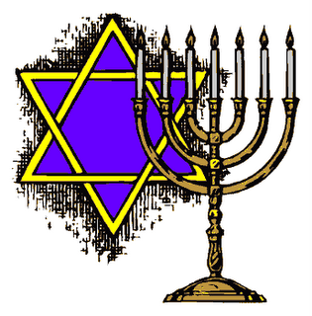
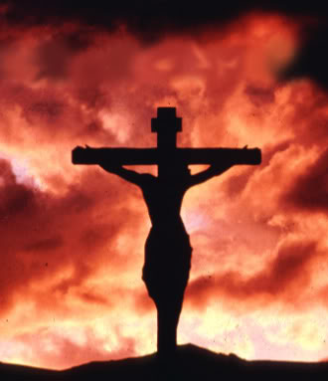
Religion
3 religions call the middle east there homeland
All 3 can trace there roots back to the biblical figure Abraham.
Judaism
Christianity
Islam

Slide 3
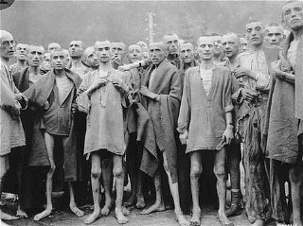
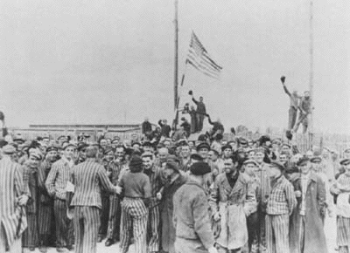
The Holocaust
Several thousand Jews survived the concentration camp
thousands more were displaced from their homes by Nazi policy
They had no where to go

Slide 4
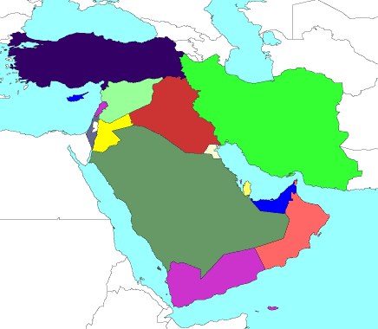
The Homeland
The Idea was to send them back to their historical homeland near Jerusalem
The only problem was that since the Jews left millions of Muslims lived there and call it their homeland
England and America supported creation of a a new Jewish state= Israel.

Slide 5
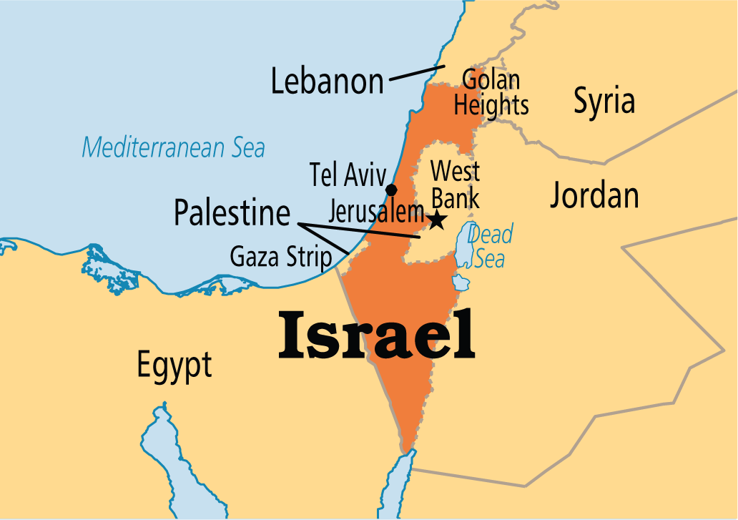
The Homeland

Slide 6
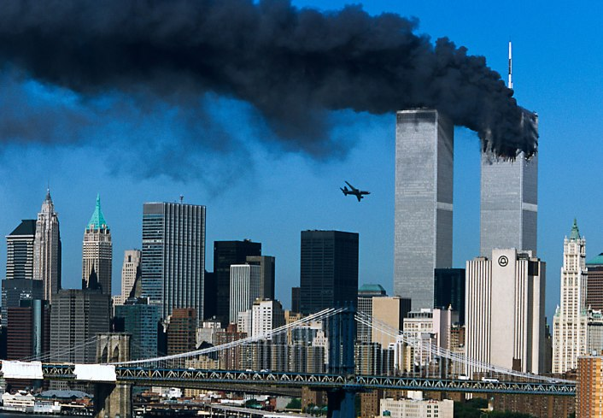
The Problem
Since the creation of Israel surrounding Muslim countries have laid claim to the land
It has caused violence on both sides
The US has been and continues to support Israel
It is the #1 (but not the only) problem between America and the Muslim world

Slide 7
Trouble in the Suez
Where is the Suez?

Slide 8
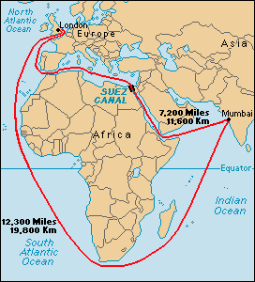
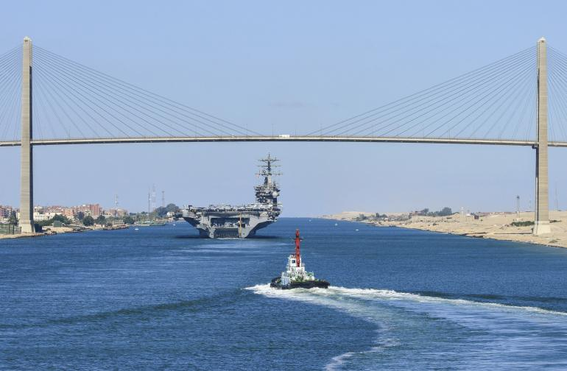

Slide 9
Suez Crisis
1956, Israel sends troop to Egypt after Egyptian president (Nasser) took control of the Canal previously ran by the British
France and Britain joined Israel
The Soviet Union supported Egypt with guns and money.
It nearly causes another world war
In the end, the British, French and Israeli governments withdrew their troops in late 1956 and early 1957.

Slide 10
After the Crisis
There is growing resentment of American and NATA in the middle east
Suez Canal
Israel
The Soviet Union takes advantage by offering military aid and economic assistance to many Middle Eastern countries

