Slide 1
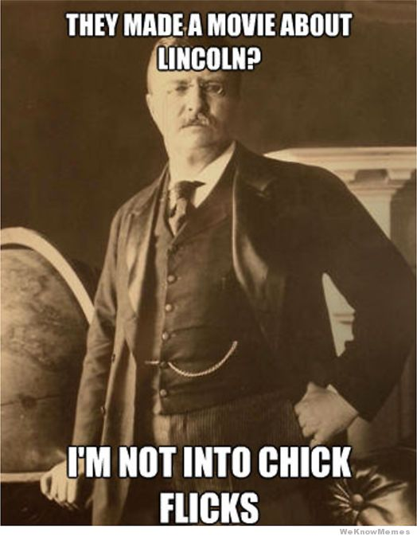
Tuesday, January 5th
Sporting News:
Senior Announcements:
Homecoming – Jan 18-23
Class Announcements:
ESD – Wednesday & Thursday 2:30-3:30
Vocab Quiz & Comp Check – Tuesday
PEP Final – Due February 12th (tentatively)
Agenda:
Journal & Vocab
Presidential Progressivism PPT & Cornell
Pres Progs Group Readings.

Slide 2
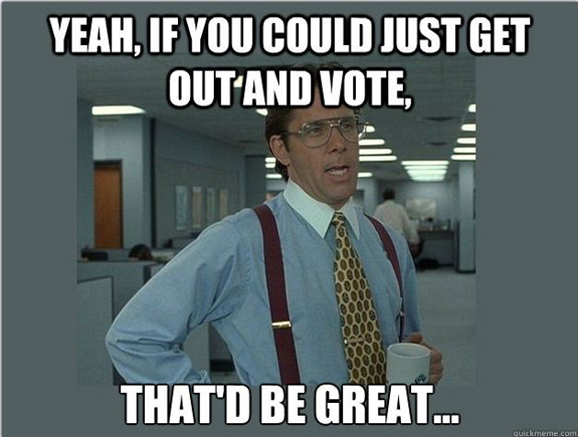
Tuesday, January 5th
Sporting News:
Class Announcements:
Agenda:
CNN Podcast
Political Parties PPT & Notes
Learning Target: I can describe the political parties in American politics and characteristics of each.
Vocabulary: political party, political structure

Slide 3
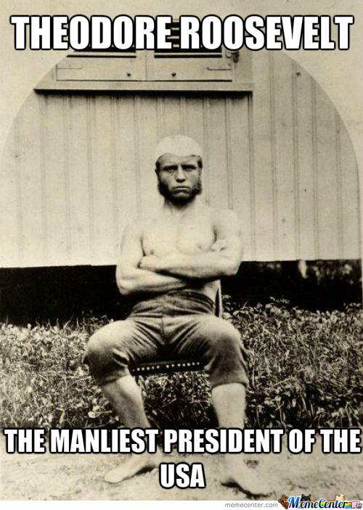
Wednesday, January 6th
Sporting News:
Senior Announcements:
Homecoming – Jan 18-23
Class Announcements:
ESD – Wednesday & Thursday 2:30-3:30
Vocab Quiz & Comp Check – Tuesday
PEP Final – Due February 11th (tentatively)
Agenda:
Journal & Vocab
Pres Progs Group Readings
Imperialism PPT & Cornell Notes

Slide 4
Wednesday, January 6th
Sporting News:
Class Announcements:
Agenda:
CNN Podcast
Political Parties PPT & Notes
On the Road with George
Learning Target: I can describe the political parties in American politics and characteristics of each.
Vocabulary: political party, political structure

Slide 5
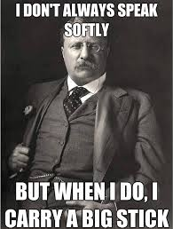
Thursday, January 7th
Sporting News:
Basketball @ Bullitt East @ 7:30
Senior Announcements:
Homecoming – Jan 18-23
Class Announcements:
ESD – Wednesday & Thursday 2:30-3:30
Vocab Quiz & Comp Check – Tuesday
PEP Final – Due February 11th (tentatively)
Agenda:
Journal & Vocab
Imperialism PPT & Cornell Notes
Imperialism Mapping

Slide 6
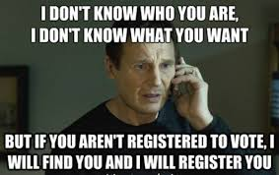
Thursday, January 7th
Sporting News:
Basketball vs. Bullitt East 7:30
Class Announcements:
Agenda:
CNN Podcast
Finish Political Parties PPT & Notes
Learning Target: I can describe the political parties in American politics and characteristics of each.
Vocabulary: primary election, incumbent

Slide 7
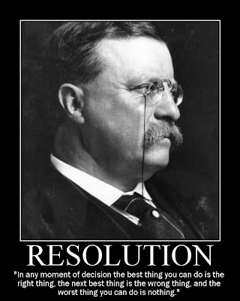
friday, January 8th
Senior Announcements:
Homecoming – Jan 18-23
Class Announcements:
Vocab Quiz & Comp Check – Tuesday
PEP Final – Due February 11th (tentatively)
Agenda:
Journal & Vocab
Finish Imperialism Mapping Activity
Finish Imperialism PPT & Cornell Notes
OR Envelope Activities Assignment

Slide 8
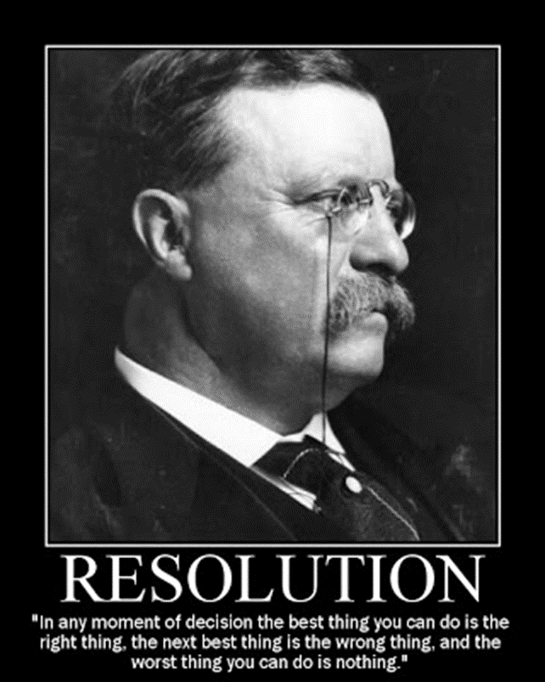
Monday, January 11th
Sporting News:
Basketball @ LIT 3:30
Senior Announcements:
Homecoming – Jan 18-23
Class Announcements:
ESD – Wednesday & Thursday 2:30-3:30
Vocab Quiz & Comp Check – Tuesday
PEP Final – Due February 11th (tentatively)
Agenda:
Journal & Vocab
Review Presidential Progressivism & Imperialism
Understanding Imperialism Activity

Slide 9
Monday, January 11th
Sporting News:
Basketball @ LIT
Class Announcements:
Agenda:
CNN Podcast
Start Journeys with George
Note Sheet that follows
Learning Target: I can describe the political parties in American politics and characteristics of each.
Vocabulary: primary election, incumbent

Slide 10
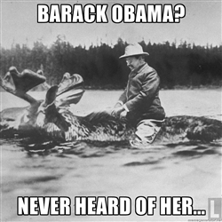
TUESDAY, January 12th
Sporting News:
Basketball @ LIT 3:30
Senior Announcements:
Homecoming – Jan 18-23, see dress down days
Need someone to do my door!!!
Class Announcements:
ESD – Wednesday & Thursday 2:30-3:30
Vocab Quiz & Comp Check – TODAY!!!
PEP Final – Due February 11th (tentatively)
Agenda:
Journal & Vocab
Vocab Quiz & Check
Review Presidential Progressivism & Imperialism

Slide 11
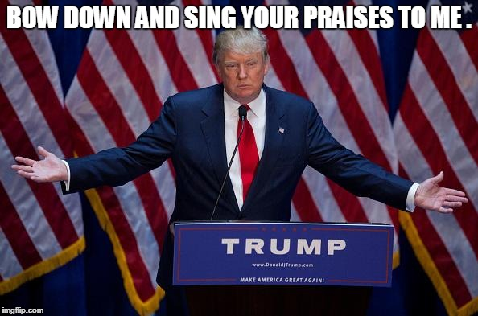
Tuesday, January 12th
Sporting News:
Basketball @ LIT 3:30
Class Announcements:
Agenda:
CNN Podcast
Start Journeys with George
Note Sheet that follows
Learning Target: I can describe the political parties in American politics and characteristics of each.
Vocabulary: PAC (Political Action Committee)

Slide 12
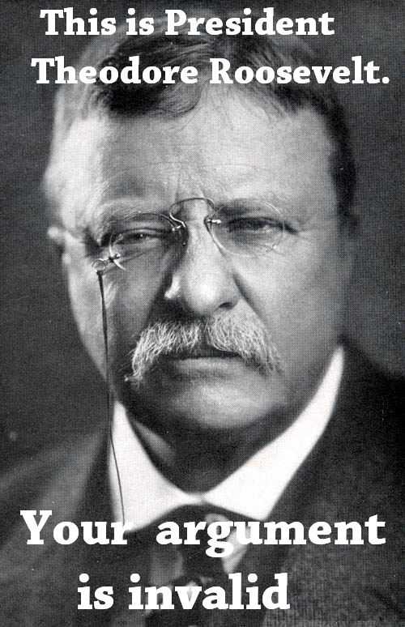
Wednesday, January 13th
Sporting News:
Senior Announcements:
Homecoming – Jan 18-23, see dress down days
Class Announcements:
ESD – Wednesday & Thursday 2:30-3:30
Comp Check – TODAY!!!
PEP Final – Due February 11th (tentatively)
Agenda:
Journal & Vocab
Finish Review Activity
Take Comp Check
Begin WWI Work Product - Vocab

Slide 13
wEDNESDAY, January 13th
Sporting News:
Class Announcements:
Agenda:
CNN Podcast
Finish Journeys with George
Review the Movie Sheet
Vocab Quiz – Elections
Discussion on Campaign Funding
Reading Sheet 17.1
Learning Target: I can describe the political parties in American politics and characteristics of each.
Vocabulary: soft money; interest group

Slide 14
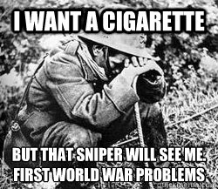
Thursday, January 14th
Sporting News:
Basketball Friday vs Ballard 7:00, $8.00
Senior Announcements:
Homecoming – Jan 19-23, see dress down days
Class Announcements:
ESD – Wednesday & Thursday 2:30-3:30
PEP Final – Due February 11th (tentatively)
Agenda:
Journal & Vocab
Review Comp Check
WWI PPT & Cornell
WWI Vocab & Timeline; Check Work Products!!!!

Slide 15
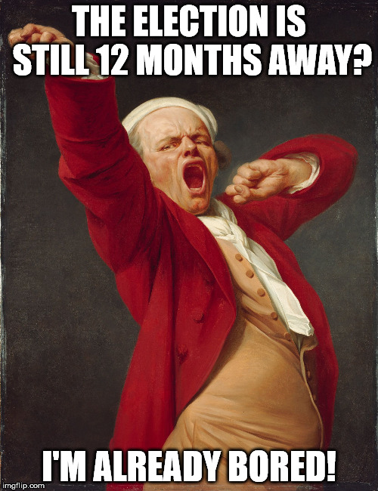
Thursday, January 14th
Sporting News:
Basketball LIT Friday vs. Ballard @ Valley 7:00
Class Announcements:
Nominate for Homecoming during lunch
Agenda:
CNN Podcast
Discussion on Campaign Funding
Reading Sheet 17.1
Learning Target: I can describe the election process and the concepts behind campaign funding.
Vocabulary: absentee vote; exit poll

Slide 16
Friday, January 15th
Sporting News:
Basketball TONIGHT vs Ballard 7:00, $8.00
Senior Announcements:
Homecoming – Jan 19-23, see dress down days
Class Announcements:
ESD – Wednesday & Thursday 2:30-3:30
PEP Final – Due February 11th (tentatively)
Agenda:
Journal & Vocab
WWI Vocab & Timeline; Check Work Products!!!!
Why We Enter WWI

Slide 17
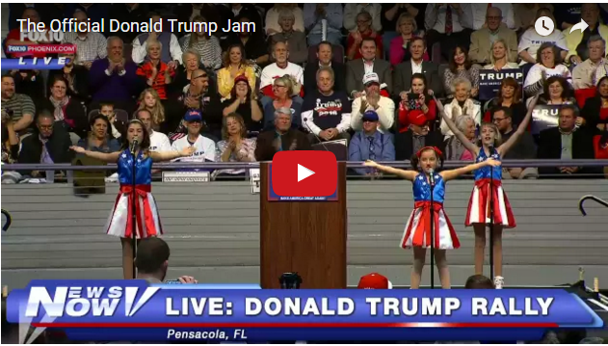
Friday, January 15th
Sporting News:
Class Announcements:
Agenda:
CNN Podcast
Discussion on Campaign Funding
Reading Sheet 17.1
Learning Target: I can describe the political parties in American politics and characteristics of each.
Vocabulary: public funding, private funding, FECA

