Slide 1
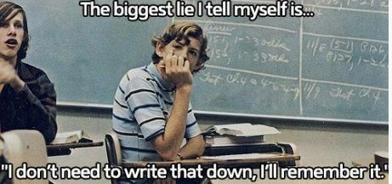
Monday, November 9th
Sporting News:
Playoff Football vs. North Bullitt Friday 7:30 (extra credit!)
Senior Announcements:
Next Trip Payment due November 19th
Class Announcements:
US History Agreement – due Wednesday
Reconstruction Comp Check, Vocab (& Map) – Thursday
Agenda:
Learning Target & Vocab
Brief Syllabus Overview
Seating Arrangements
Reconstruction Vocab

Slide 2
Monday, November 9th
Sporting News:
Playoff Football vs. North Bullitt Friday 7:30 (extra credit!)
Senior Announcements:
Next Trip Payment due November 19th
Class Announcements:
Agenda:
Learning Target & Vocab
Brief Syllabus Overview
Seating Arrangements
Bill of Rights Vocab

Slide 3
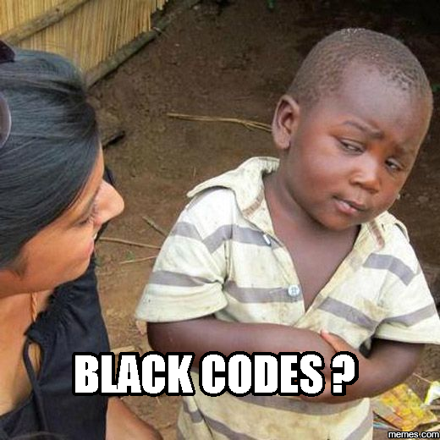
Tuesday, November 10th
Sporting News:
Playoff Football vs. North Bullitt Friday 7:30 (extra credit!)
Senior Announcements:
Next Trip Payment due November 17th
Class Announcements:
US History Agreement – due Wednesday
Reconstruction Comp Check, Vocab (& Map) – Thursday
Agenda:
Learning Target, Vocab & Reflection Question
Reconstruction PPT Part I
Black Codes Jigsaw Activity
Wrap-Up

Slide 4
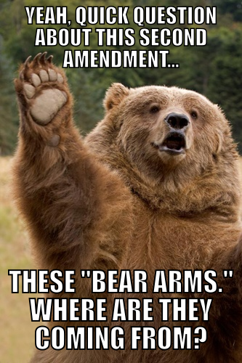
Tuesday, November 10th
Sporting News:
Playoff Football vs. North Bullitt Friday 7:30 (extra credit!)
Class Announcements:
New syllabus and procedures coming next week.
Agenda:
Learning Target & Vocab
Bill of Rights Vocab
Amending the Constitution Rdg Sheet
Begin the BOR Project.
Learning Target – I can explain how the Constitution is amended (changed.)
Vocabulary: Amend; Ratify

Slide 5
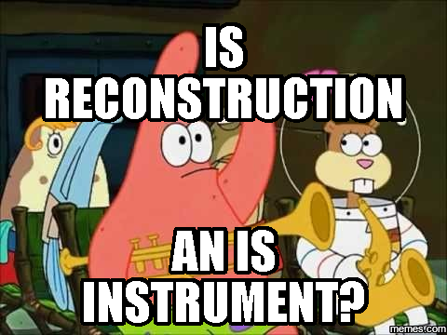
Wednesday, November 11th
Sporting News:
Playoff Football vs. North Bullitt Friday 7:30 (extra credit!)
Senior Announcements:
Next Trip Payment due November 17th
Class Announcements:
US History Agreement – due NOW!
Reconstruction Comp Check, Vocab (& Map) – tomorrow!
Agenda:
Learning Target & Vocab
Reflection – Black Codes
Group Task – the three plans
Reconstruction Mapping Activity

Slide 6
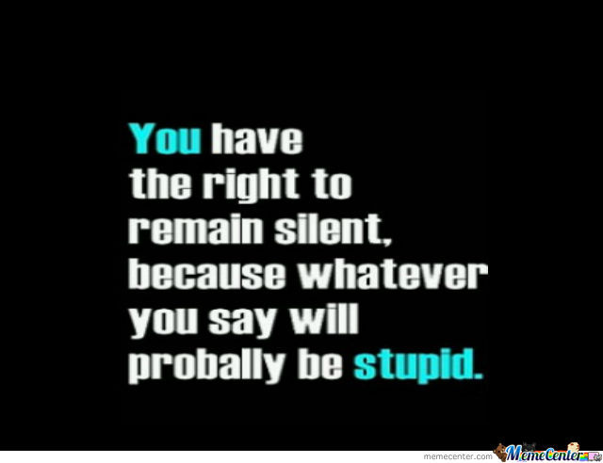
Wednesday, November 11th
Sporting News:
Playoff Football vs. North Bullitt Friday 7:30 (extra credit!)
Class Announcements:
New syllabus and procedures coming next week.
Agenda:
Continue working on the BOR Project.
Due FRIDAY!!!
Learning Target – I can continue to work on my BOR Project.
Vocabulary: none, work on BORP

Slide 7
BORP Checklist
Is your presentation REALLY wordy?
If so, reduce the amount of words. We want to pay attention to your voice not the words.
Do you have enough visuals? Do they represent your BOR well?
Can you VERBALLY explain the historical reasoning of your BOR? In other words, can you tell me WHY it needed to be an amendment?
Can YOU speak on this topic?
If not, make sure you review talking points before presenting.
WOULD I USE THIS PRESENTATION TO TEACH OTHER CLASSES ABOUT THAT AMENDMENT????? (Yes, that is how good I’d like these to be.)
☺

Slide 8
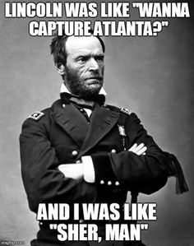
THURSDAY, November 12th
Sporting News:
Playoff Football vs. North Bullitt Friday 7:30 (extra credit!)
Senior Announcements:
Next Trip Payment due November 17th
Class Announcements:
Reconstruction Vocab Quiz – Today
Reconstruction Comp Check & Map – tomorrow!
Agenda:
Learning Target & Vocab
Vocab Quiz
Group Task – the three plans; finish discussing
Reconstruction Mapping Activity

Slide 9
Thursday, November 12th
Sporting News:
Playoff Football vs. North Bullitt Friday 7:30 (extra credit!)
Class Announcements:
New syllabus and procedures coming next week.
Agenda:
Continue working on the BOR Project.
Due FRIDAY!!!
Learning Target – I can continue to work on my BOR Project.
Vocabulary: none, work on BORP

Slide 10
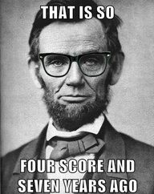
FRIDAY, November 13th
Sporting News:
Playoff Football vs. North Bullitt TONIGHT 7:30 (extra credit!)
Senior Announcements:
Next Trip Payment due November 17th
Class Announcements:
Reconstruction Comp Check & Map - Today
Agenda:
Learning Target & Vocab
Make final touches to WORK PRODUCT
Take Reconstruction CC
Remediation or Enrichment

Slide 11
Friday, November 13th
Sporting News:
Playoff Football vs. North Bullitt TONIGHT 7:30 (extra credit!)
Class Announcements:
New syllabus and procedures coming next week.
Agenda:
Work BOR Project until lunch
Present after lunch; discuss limitations of the amendments
Learning Target – I can continue to work on my BOR Project.
Vocabulary: none, work on BORP

