Slide 1
Wednesday, April 27th
Learning Target:
I can analyze and describe major domestic issues of the 1970s including Watergate and the Oil Crisis.
Vocabulary:
Watergate: Break-in at the Democratic National Committee headquarters at the Watergate building in 1972 that resulted in a cover-up and the resignation of Nixon
Oil Crisis 1973: Caused by OPEC embargo due to US support for Israel in Yom Kippur War

Slide 2
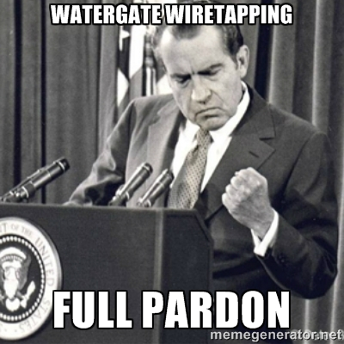
Wednesday, April 27th
Sporting News:
Baseball/Softball
Spring Football Game & Bunny Bowl - Friday
Senior Announcements:
18 days until EOC!!!!
Prom & Belle Cruise This Week = $85
Class Announcements:
Comp Check 1970s/80s – Friday (10 ?s)
Practice EOC – next Monday
PEP (Weebly) – due May 3rd
Agenda:
LT & Vocab
Learn about the Ladies
Watergate Video & Questions
1970s Domestic Issues
Exit Question

Slide 3
Wednesday, April 27th
Exit Question(s):
1. What is the lasting impact Watergate will have on the American public?
2. How is New Federalism a reaction to LBJ’s Great Society?
3. Give at least one cause of the Oil Crisis of 1973:

Slide 4
Thursday, April 28th
Learning Target:
I can analyze and describe major foreign issues of the 1970s including the Iranian Hostage Crisis.
Vocabulary:
Détente: A lessening of tensions between U.S. and Soviets. Focused on disarming missiles to insure a lasting peace between superpowers & pressed for trade relations and a limited military budget.
Iranian Hostage Crisis: Iranian fundamentalists seized the US embassy & held 53 American diplomats hostage for over a year; weakened Carter's presidency; hostages released on Reagan's inauguration.
Oil Embargo: Economic crisis of 1973 that occurred when OPEC nations refused to export oil to Western nations.

Slide 5
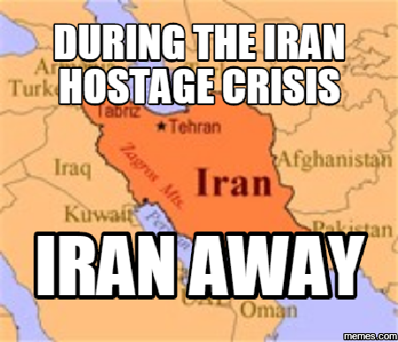
Thursday, April 28th
Sporting News:
Baseball/Softball
Spring Football Game & Bunny Bowl - Friday
Senior Announcements:
18 days until EOC!!!!
Prom & Belle Cruise This Week = $85
Class Announcements:
Comp Check 1970s/80s – Friday (10 ?s)
Practice EOC – next Monday
PEP (Weebly) – due May 3rd
Agenda:
LT & Vocab
Learn about the Ladies
Watergate Video & Questions
1970s Domestic Issues
Exit Question

Slide 6
Thursday, April 28th
Exit Question(s):
1. What is the purpose of Détente? Why was it widely praised during Nixon’s presidency?
2. Give a brief summary of the Iranian Hostage Crisis:

Slide 7
Friday April 29th
Learning Target:
I can analyze and describe the presidency of Ronald Reagan
Vocabulary:
Reaganomics: Reagan's theory that if you cut taxes, it will spur the growth of public spending and improve the economy. It included tax breaks for the rich
Star Wars: President Reagan's proposed weapons system to destroy Soviet missiles from space.
Iran-Contra Affair: A political scandal in the US, 1986. During the Reagan administration, Reagan Administration secretly facilitated the sale of arms to Iran, the subject of an arms embargo in hopes of securing the release of hostages and allowing U.S. intelligence agencies to fund the Nicaraguan Contras.

Slide 8
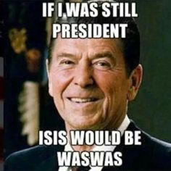
Friday April 29th
Sporting News:
Baseball/Softball
Spring Football Game & Bunny Bowl - Friday
Senior Announcements:
18 days until EOC!!!!
Prom & Belle Cruise This Week = $85
Class Announcements:
Comp Check 1970s/80s – Friday (10 ?s)
Practice EOC – next Monday
PEP (Weebly) – due May 3rd
Agenda:
LT & Vocab
Learn about the Ladies
Watergate Video & Questions
1970s Domestic Issues
Exit Question

Slide 9
Friday April 29th
Exit Question(s):
1. Why do some people believe Reaganomics worked?
2. Why do some people believe Reaganomics was a failure?

